Slide 1

Viskit: Visual Simkit Editor
Don Brutzman and Terry Norbraten
Modeling Virtual Environments Simulation (MOVES) Institute
Naval Postgraduate School (NPS)
10 June 2025

Slide 2
Overview
Viskit is a modeling application for defining Discrete Event Simulation (DES) models that autogenerate Java source using the Simkit library.
The Viskit application allows you to build a collection of Simkit event graphs that describe the behavior of various entities in a simulation environment. Each model file is recorded in XML data file.
Capabilities include Event Graphs, Assemblies, Simulation Run tools, and an Analyst Report generator suitable for thesis and research efforts.
Current release includes a thorough refactoring of the underlying Viskit source code, facilitating ongoing maintenance and development.
Open-source efforts are ongoing.

Slide 3
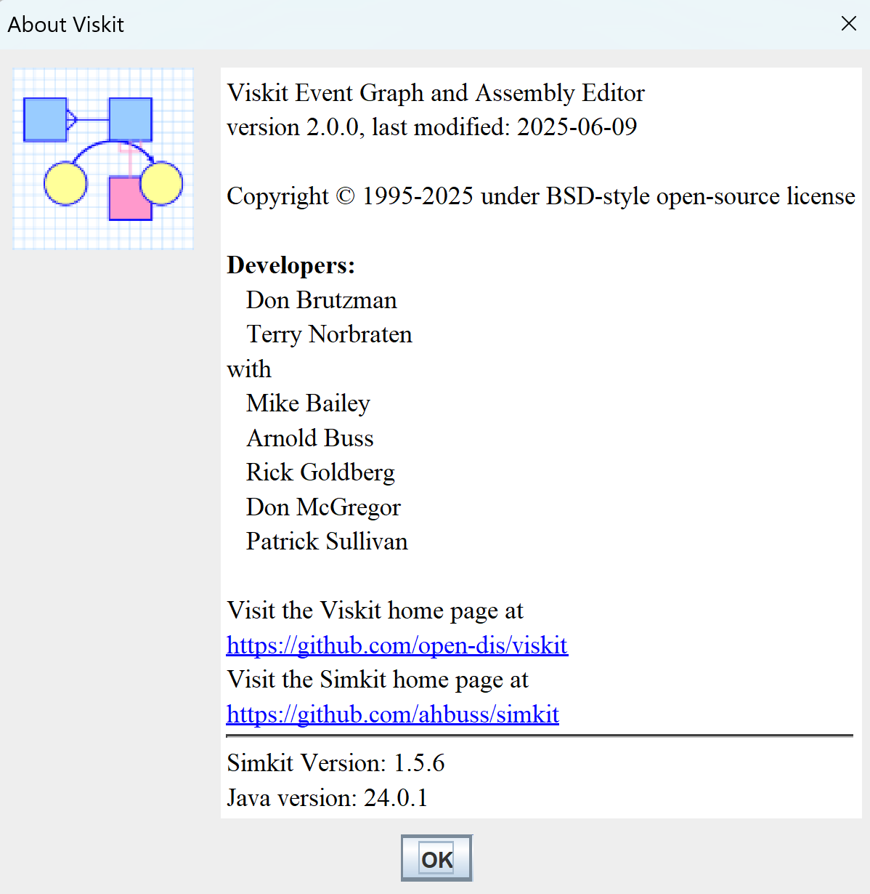
About

Slide 4
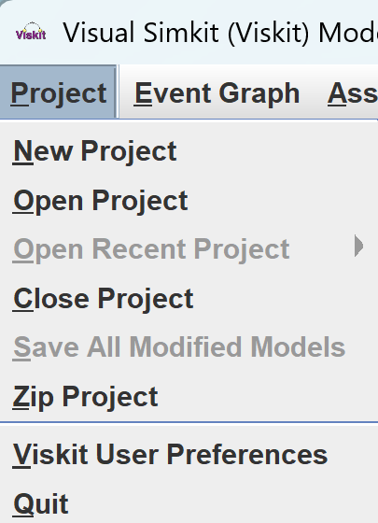
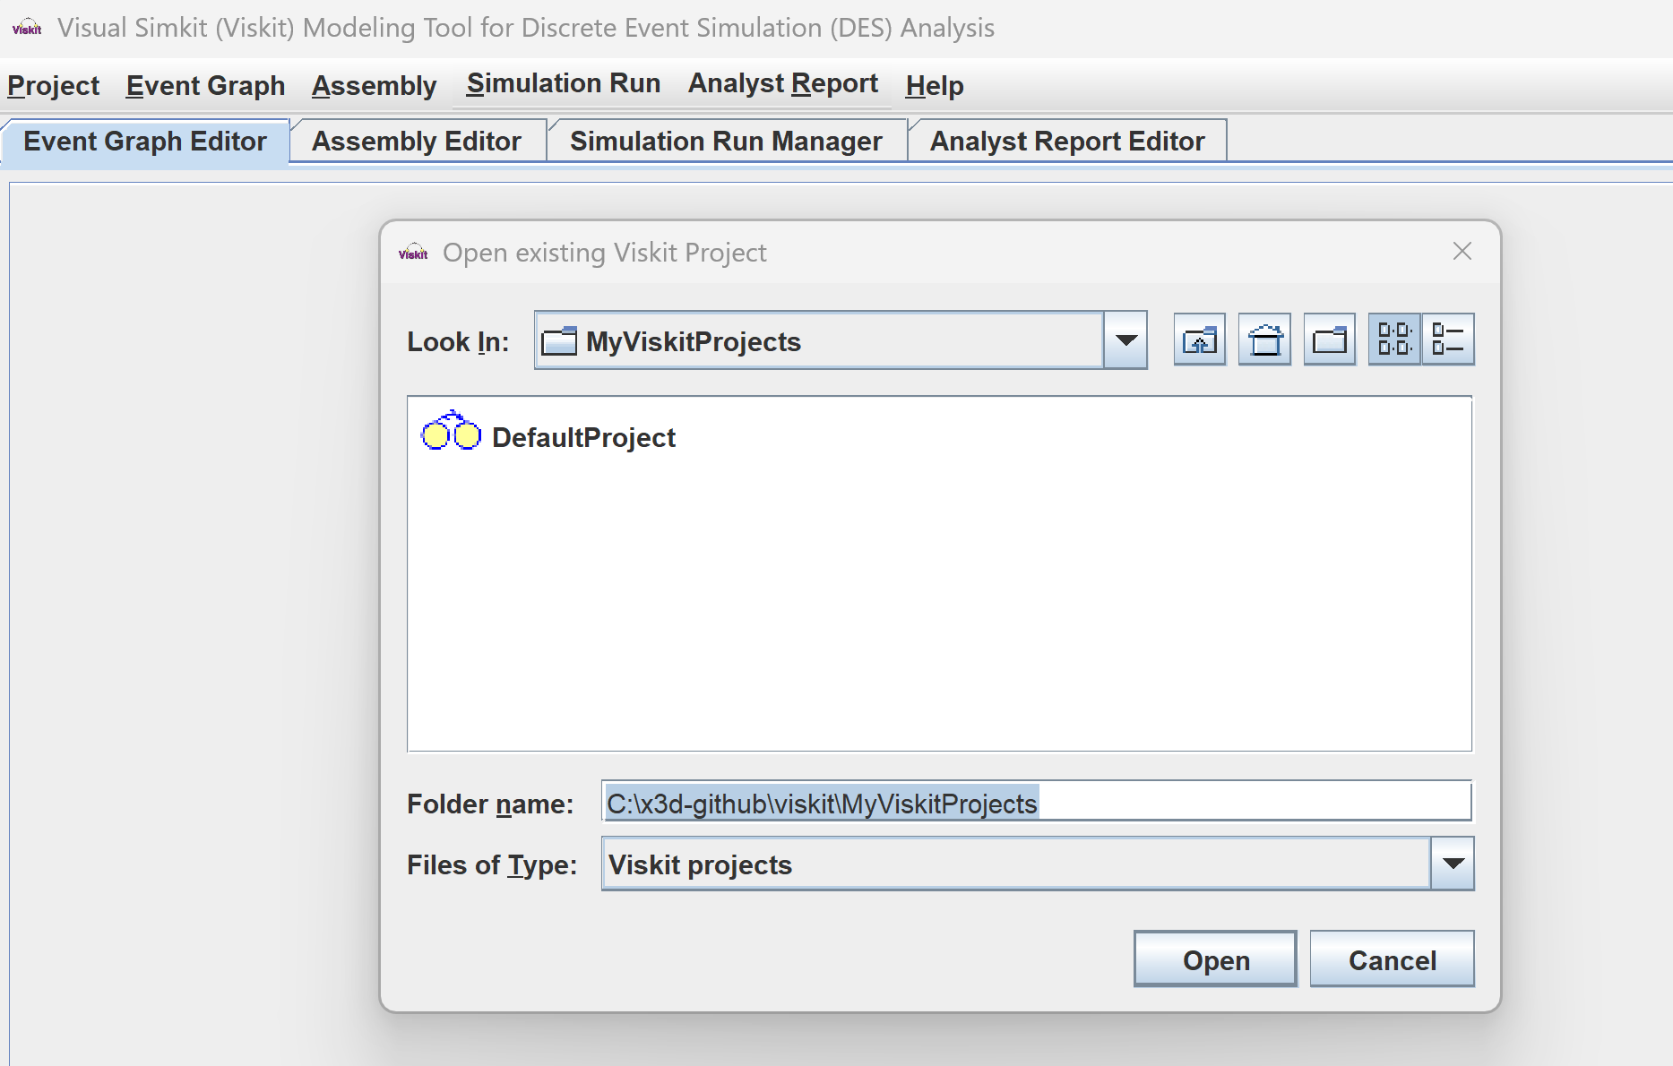
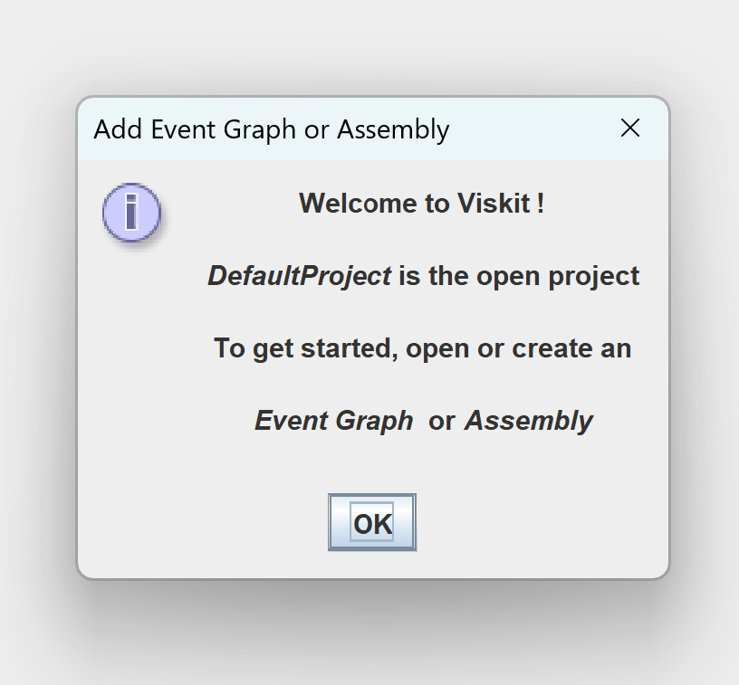
Viskit is organized according to Viskit Projects

Slide 5
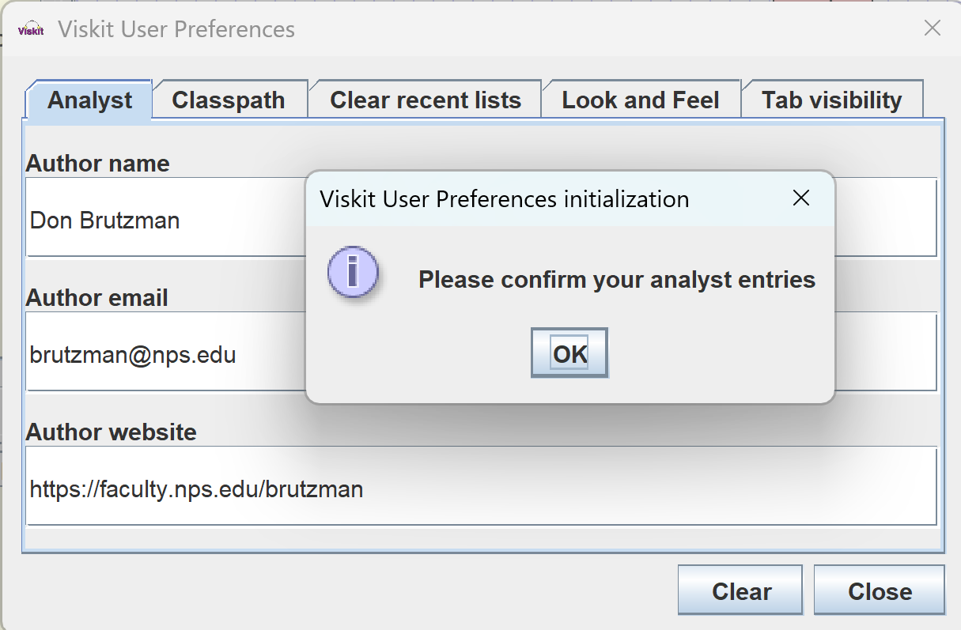
Viskit User Preferences
Author information is applied when creating an Analyst Report

Slide 6
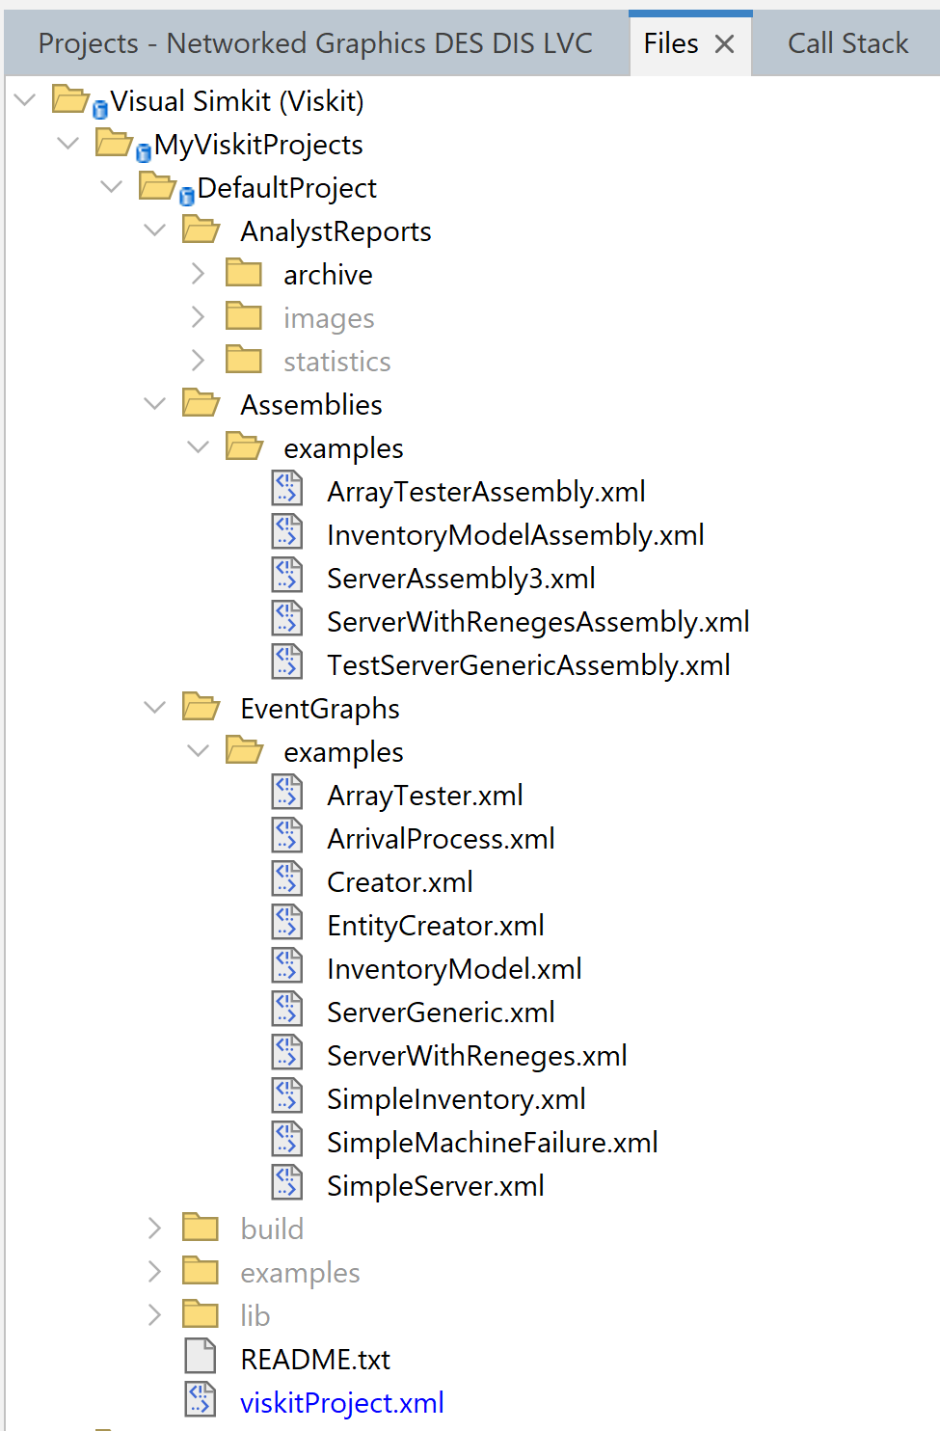
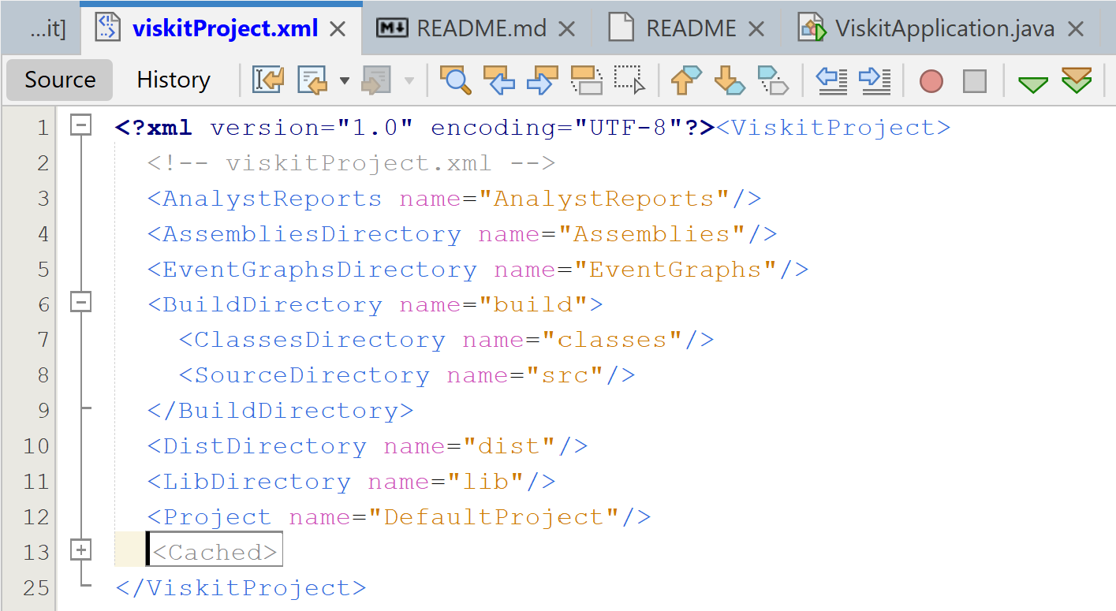
Viskit project files contain multiple assets

Slide 7
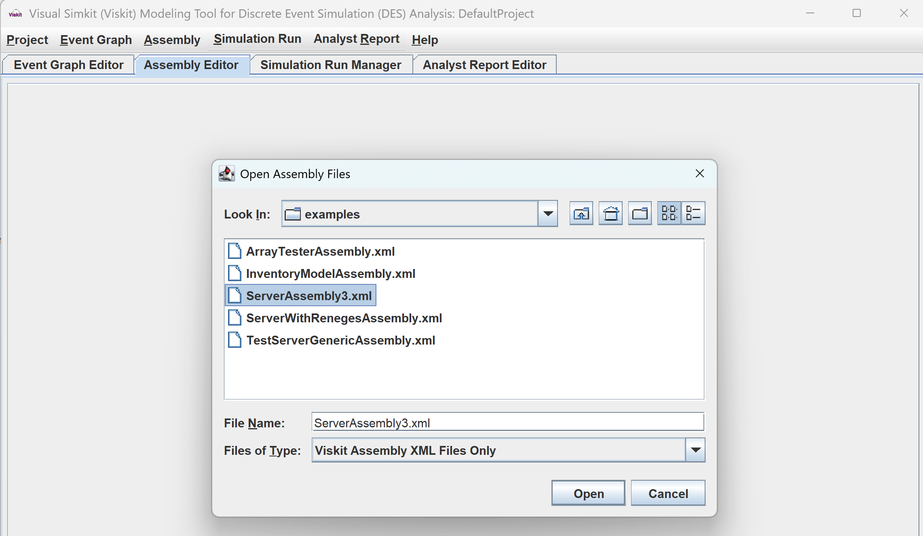
Next step: open an assembly

Slide 8
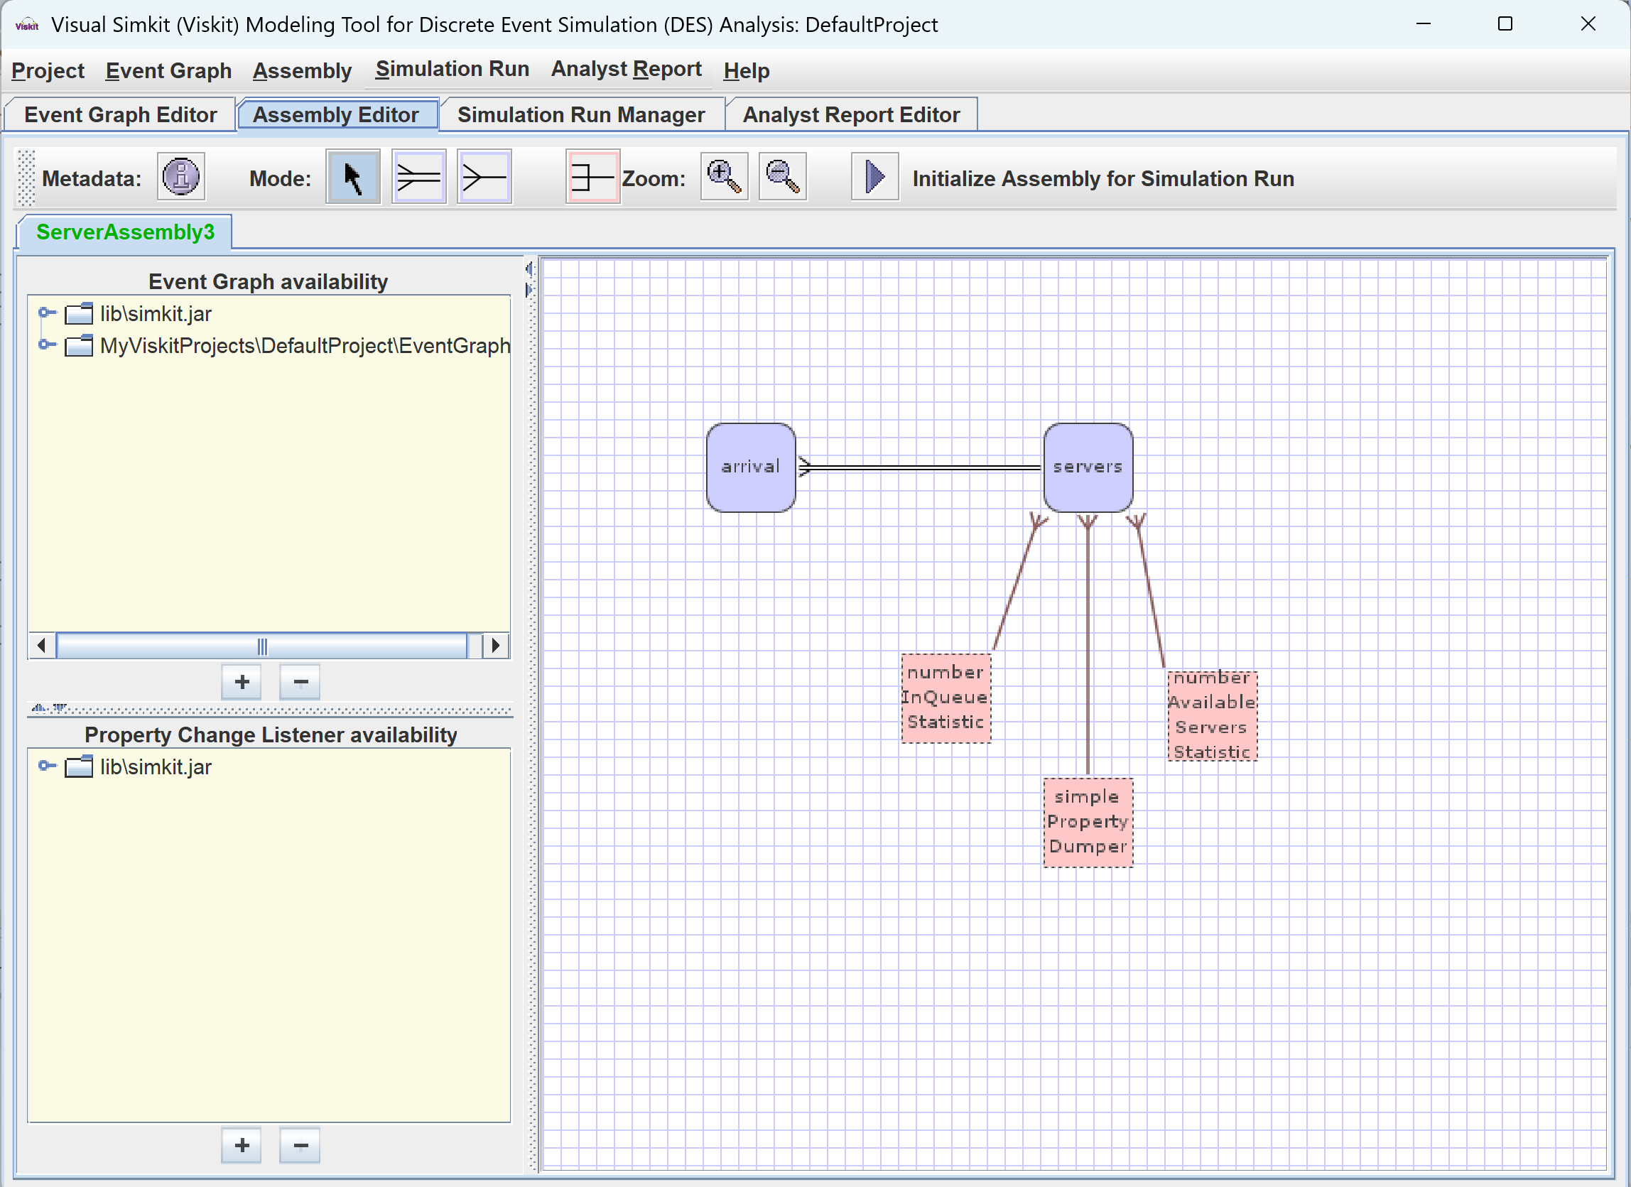
For example Server Assembly3 .xml

Slide 9
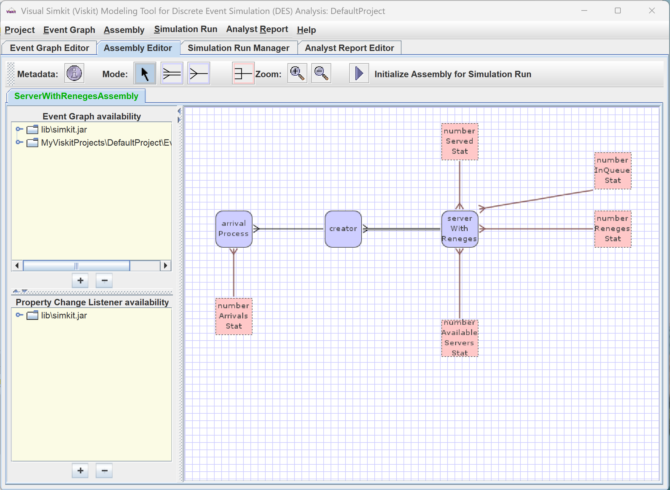
For example Server WithReneges Assembly .xml

Slide 10
Editing
You can edit Event Graphs, Assemblies, Simulation Run results, and
Analyst Report outputs

Slide 11
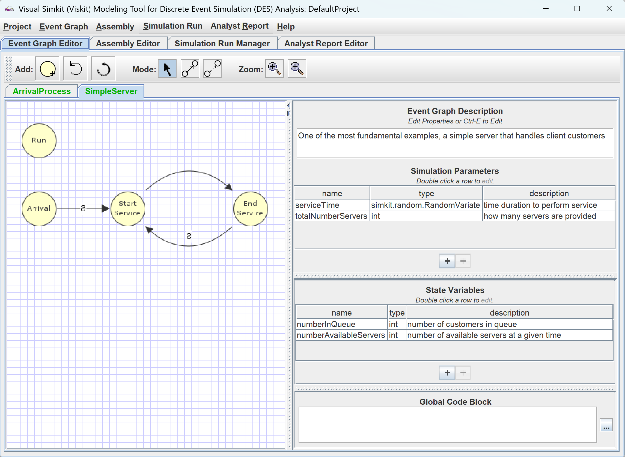
Check that corresponding Event Graphs were opened
Check out
Event Graphs
Simulation Parameters and State Variables

Slide 12
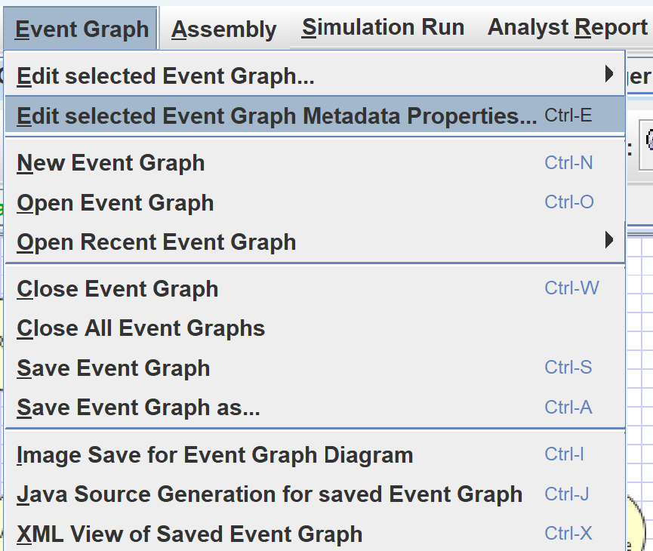
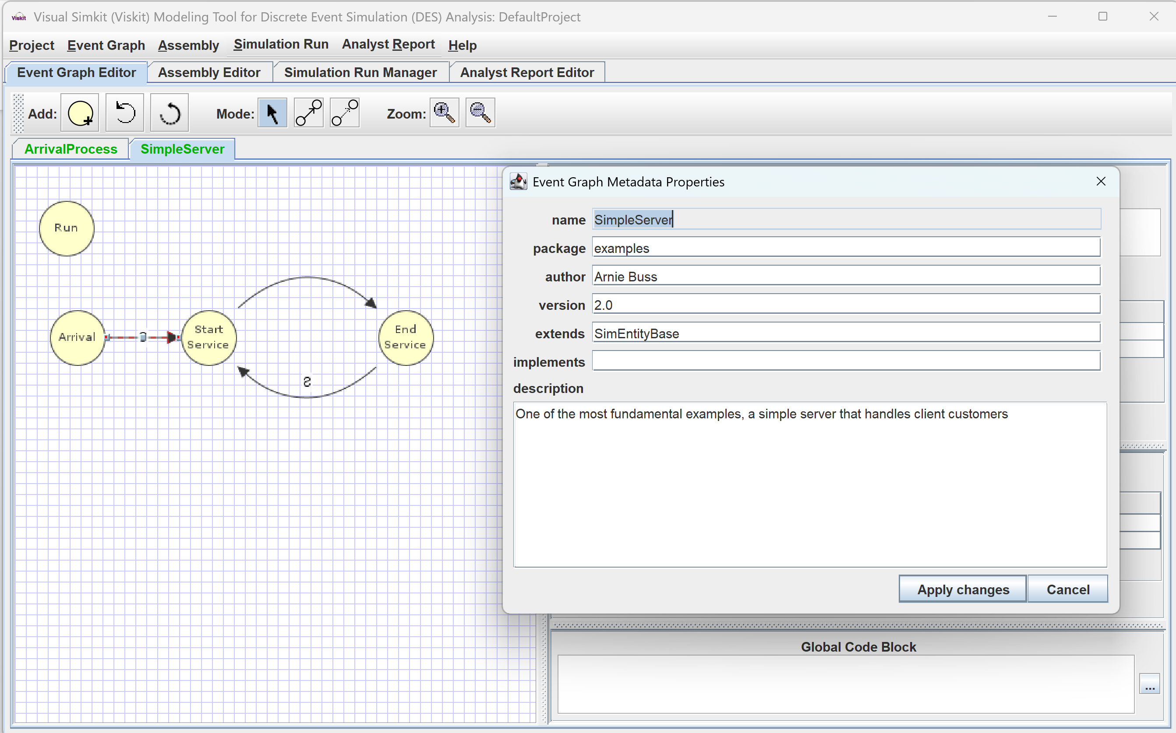
Editing an Event Graph Inspect Metadata

Slide 13
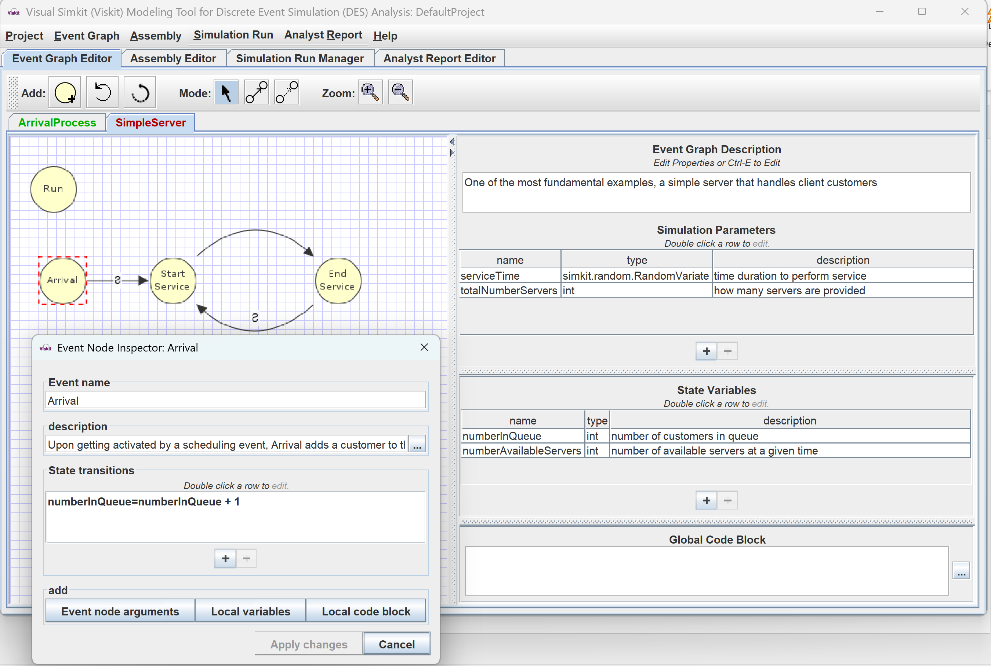
Editing an Event Graph Simple Server.xml Inspect State Nodes

Slide 14
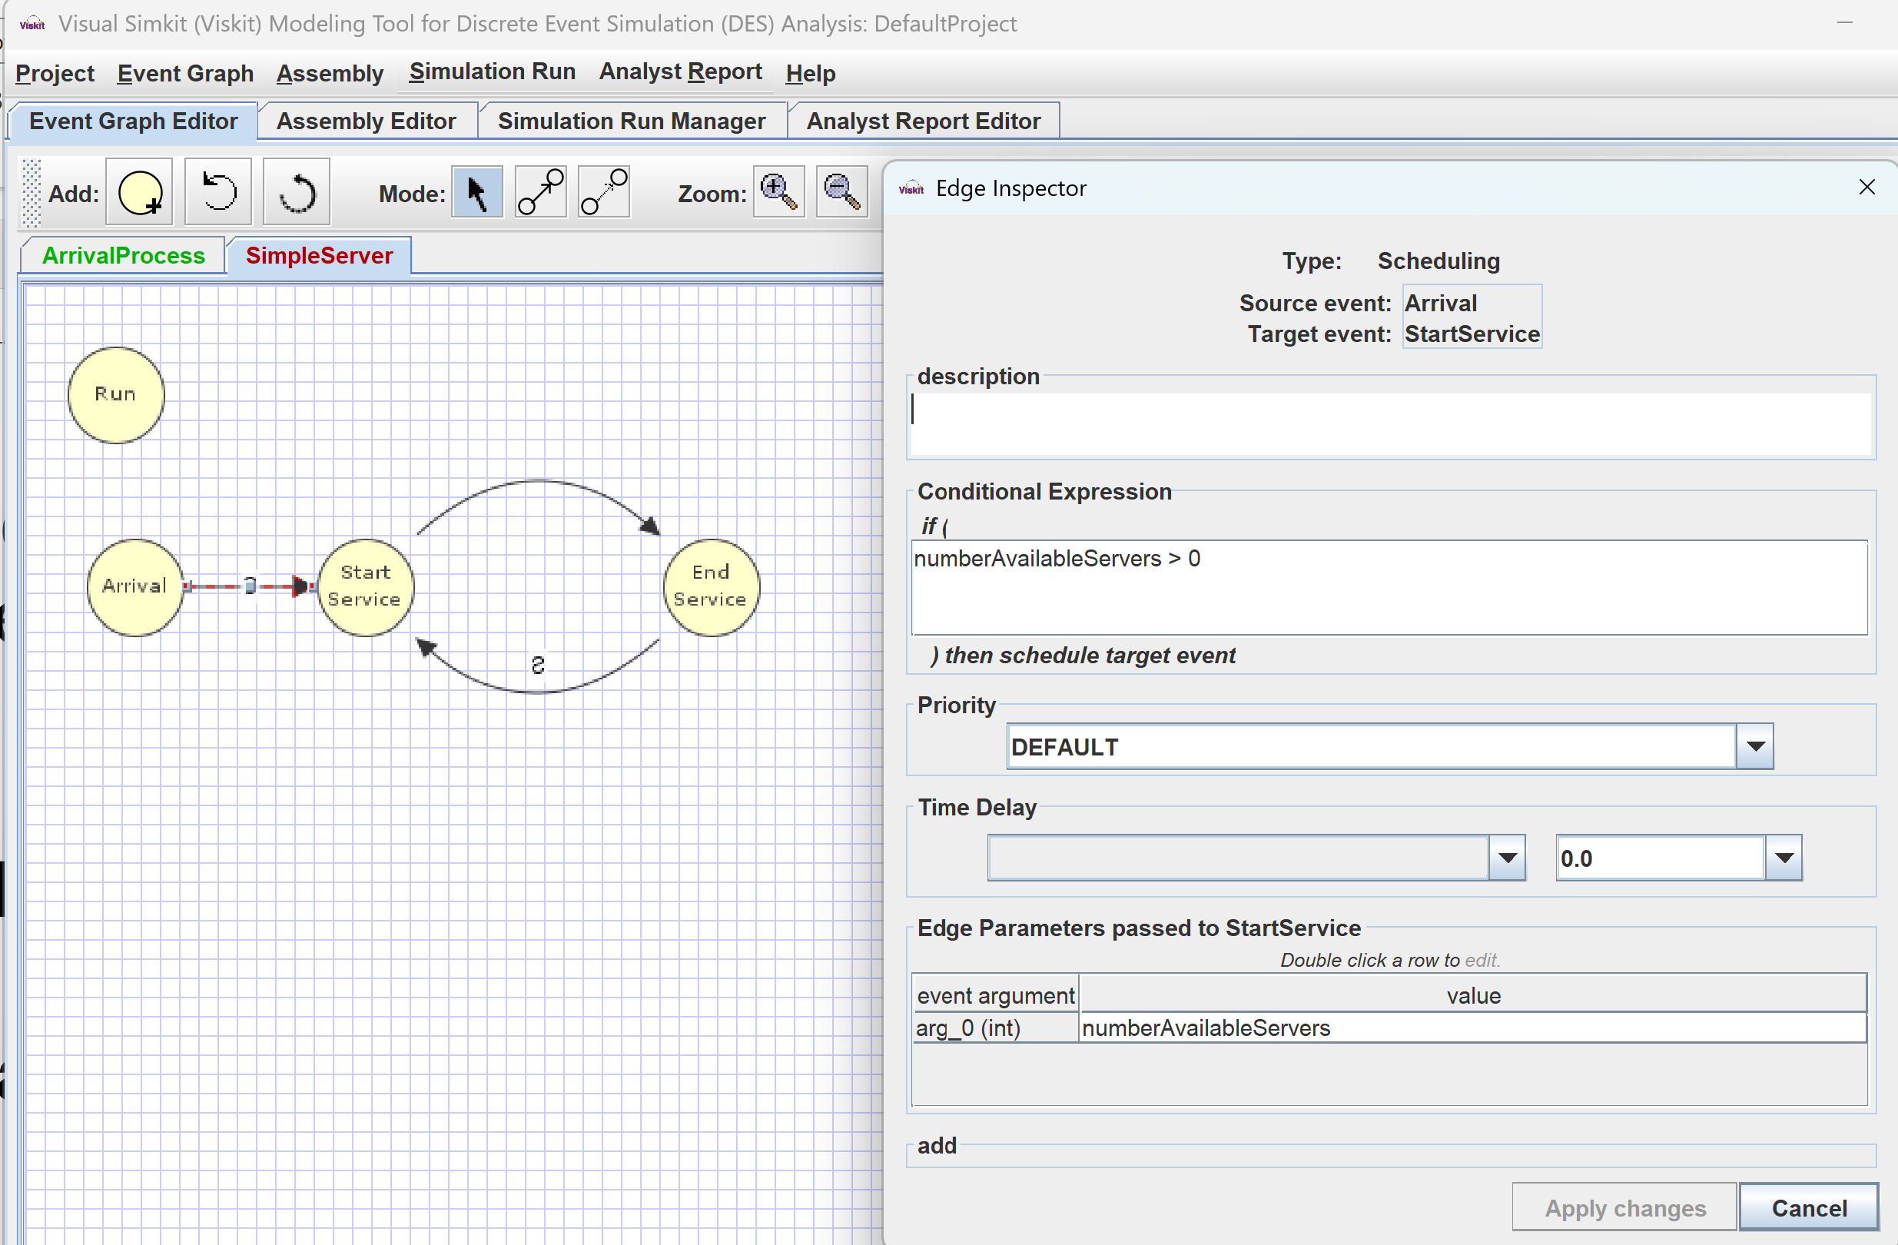
Editing an Event Graph Inspect Scheduling (Cancelling) Edge Transitions
Good descriptions matter!

Slide 15
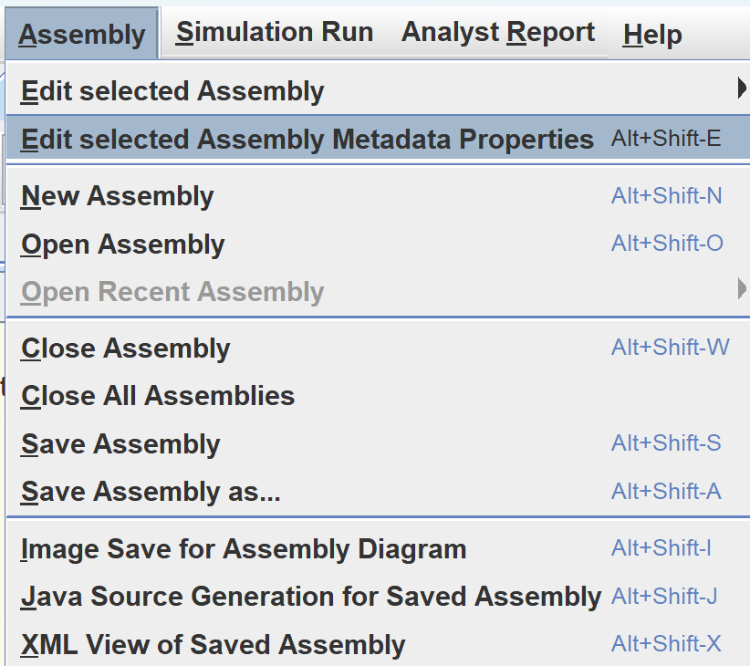
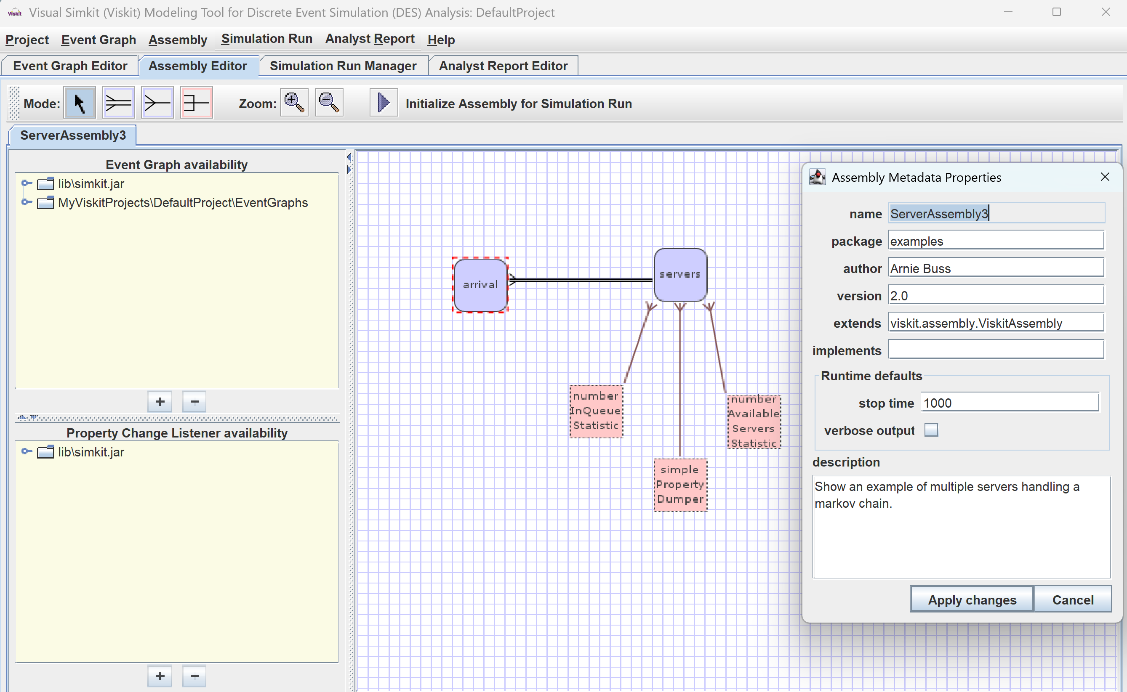
Editing an assembly Inspect Metadata

Slide 16
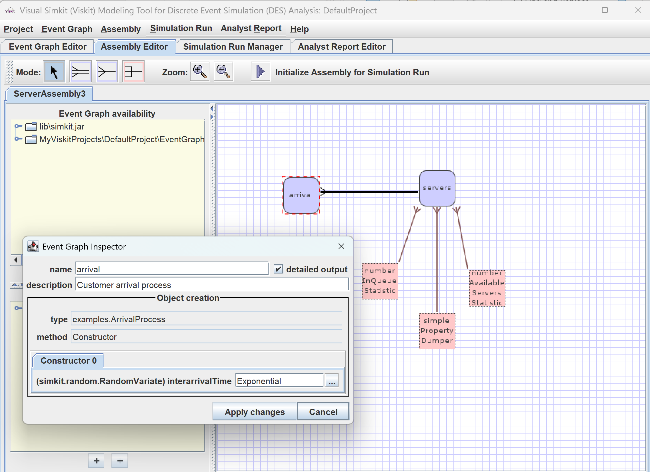
Editing an assembly Inspect Event Graph nodes

Slide 17
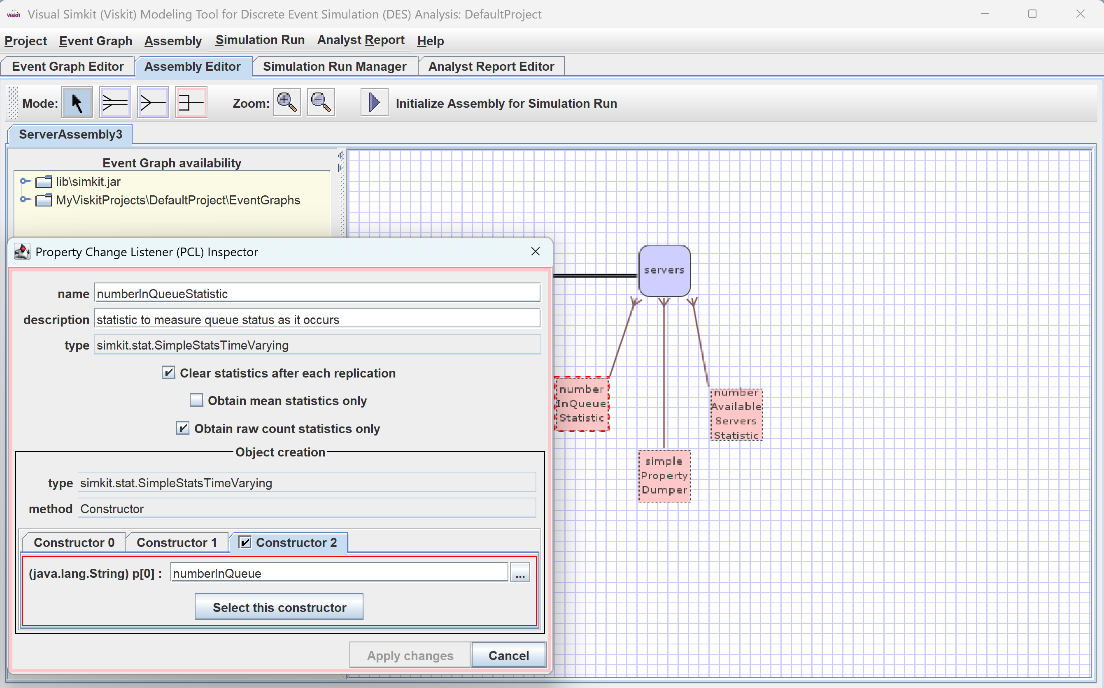
Editing an assembly Inspect Property Change Listeners PCLs

Slide 18
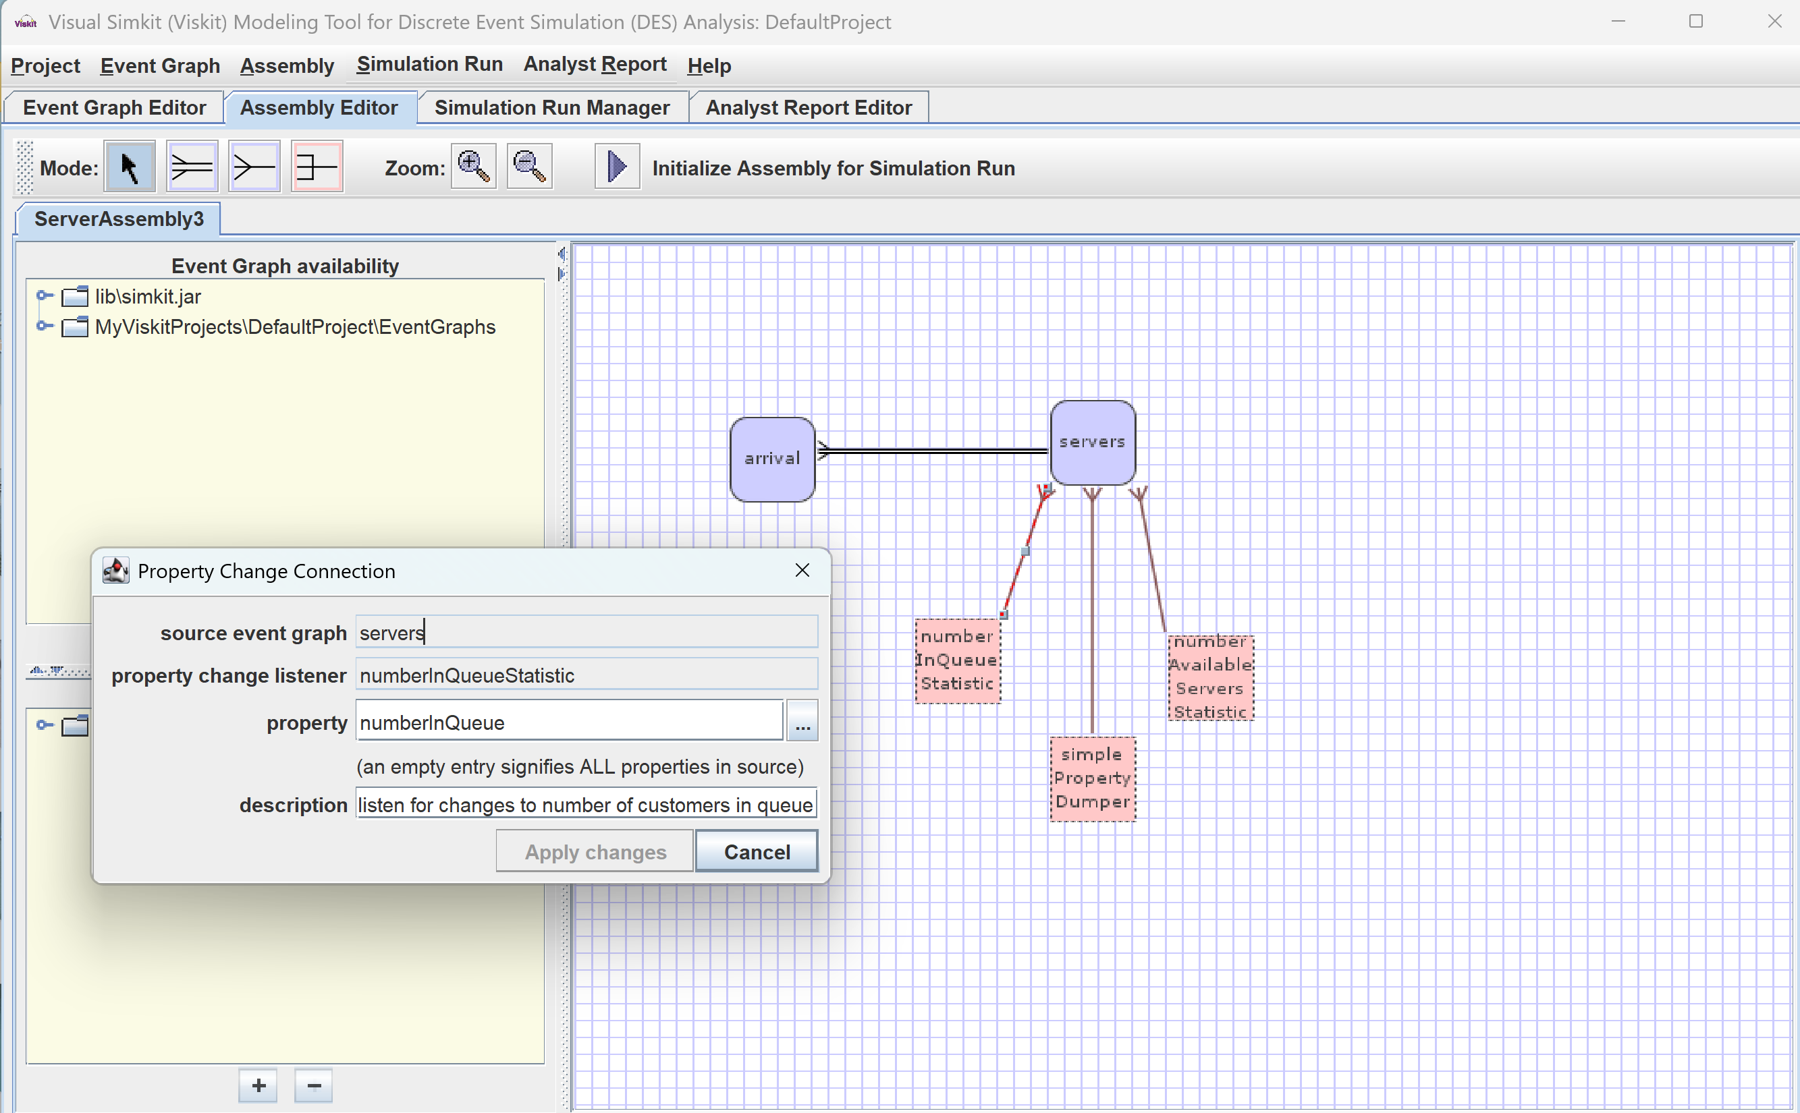
Editing an assembly Inspect Property Change Connection

Slide 19
Run Simulation Replications
Rehearse and repeat, either for preliminary tests or for numerous repetitions

Slide 20
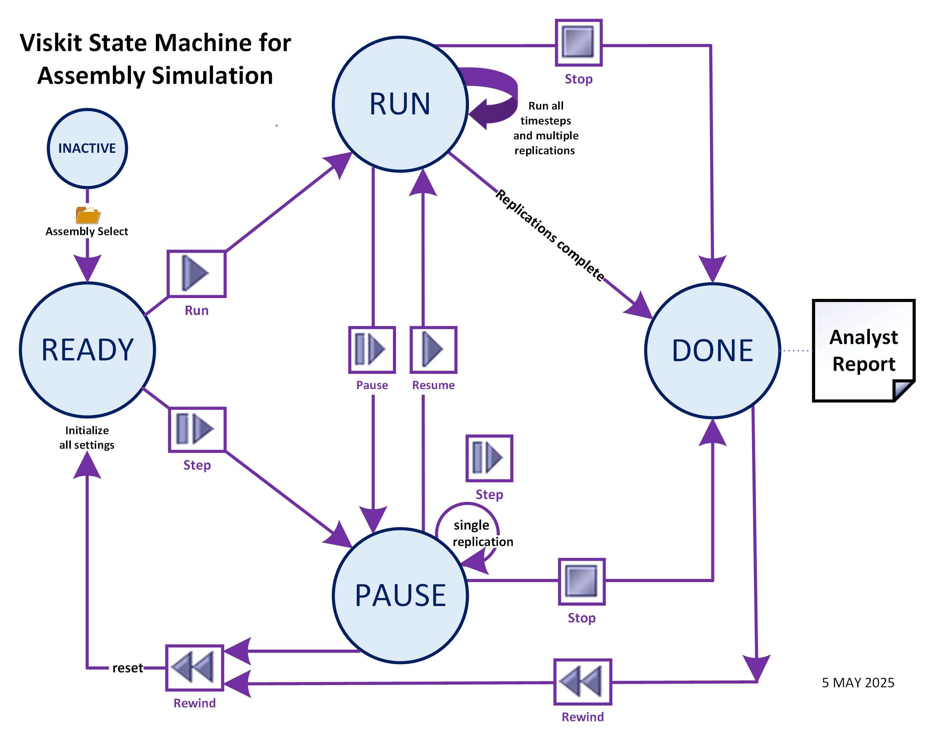
State Machine for Assembly Simulation Replications
User buttons
are simple:
Run Pause Stop
This diagram shows underlying Viskit operations

Slide 21
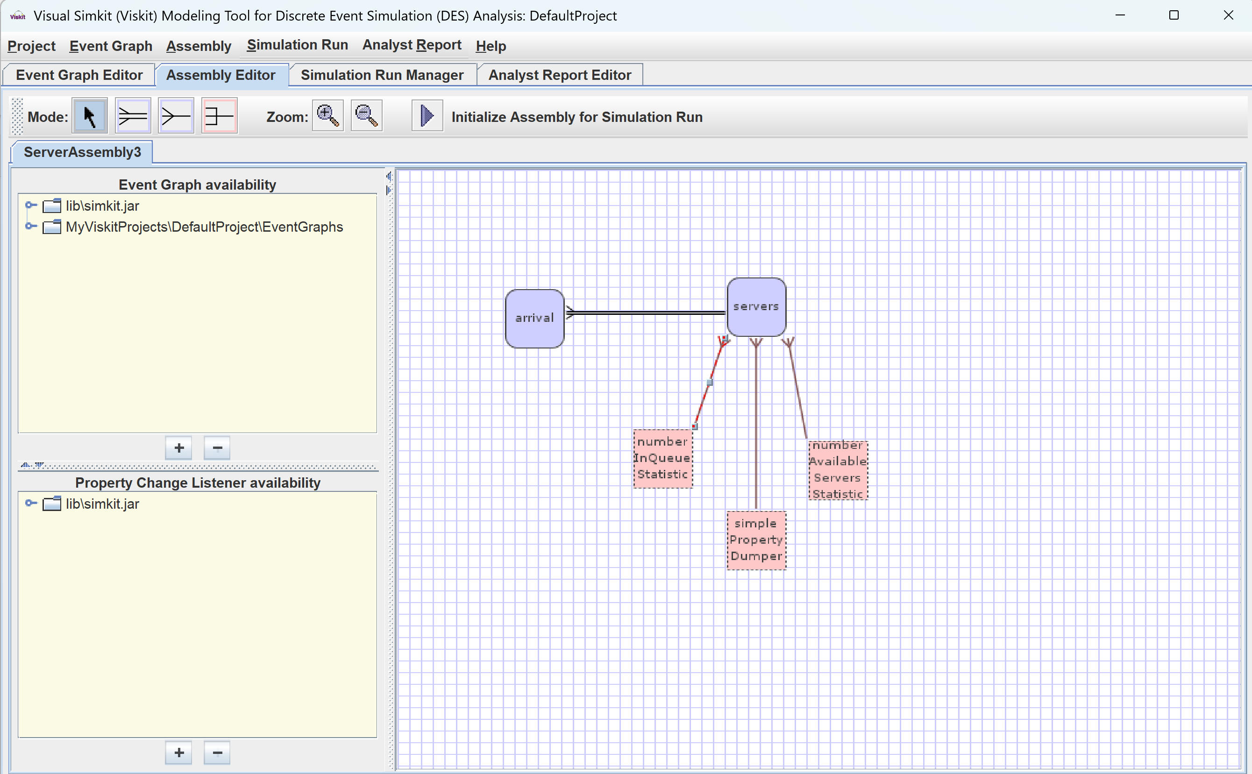
Ready to run simulations

Slide 22
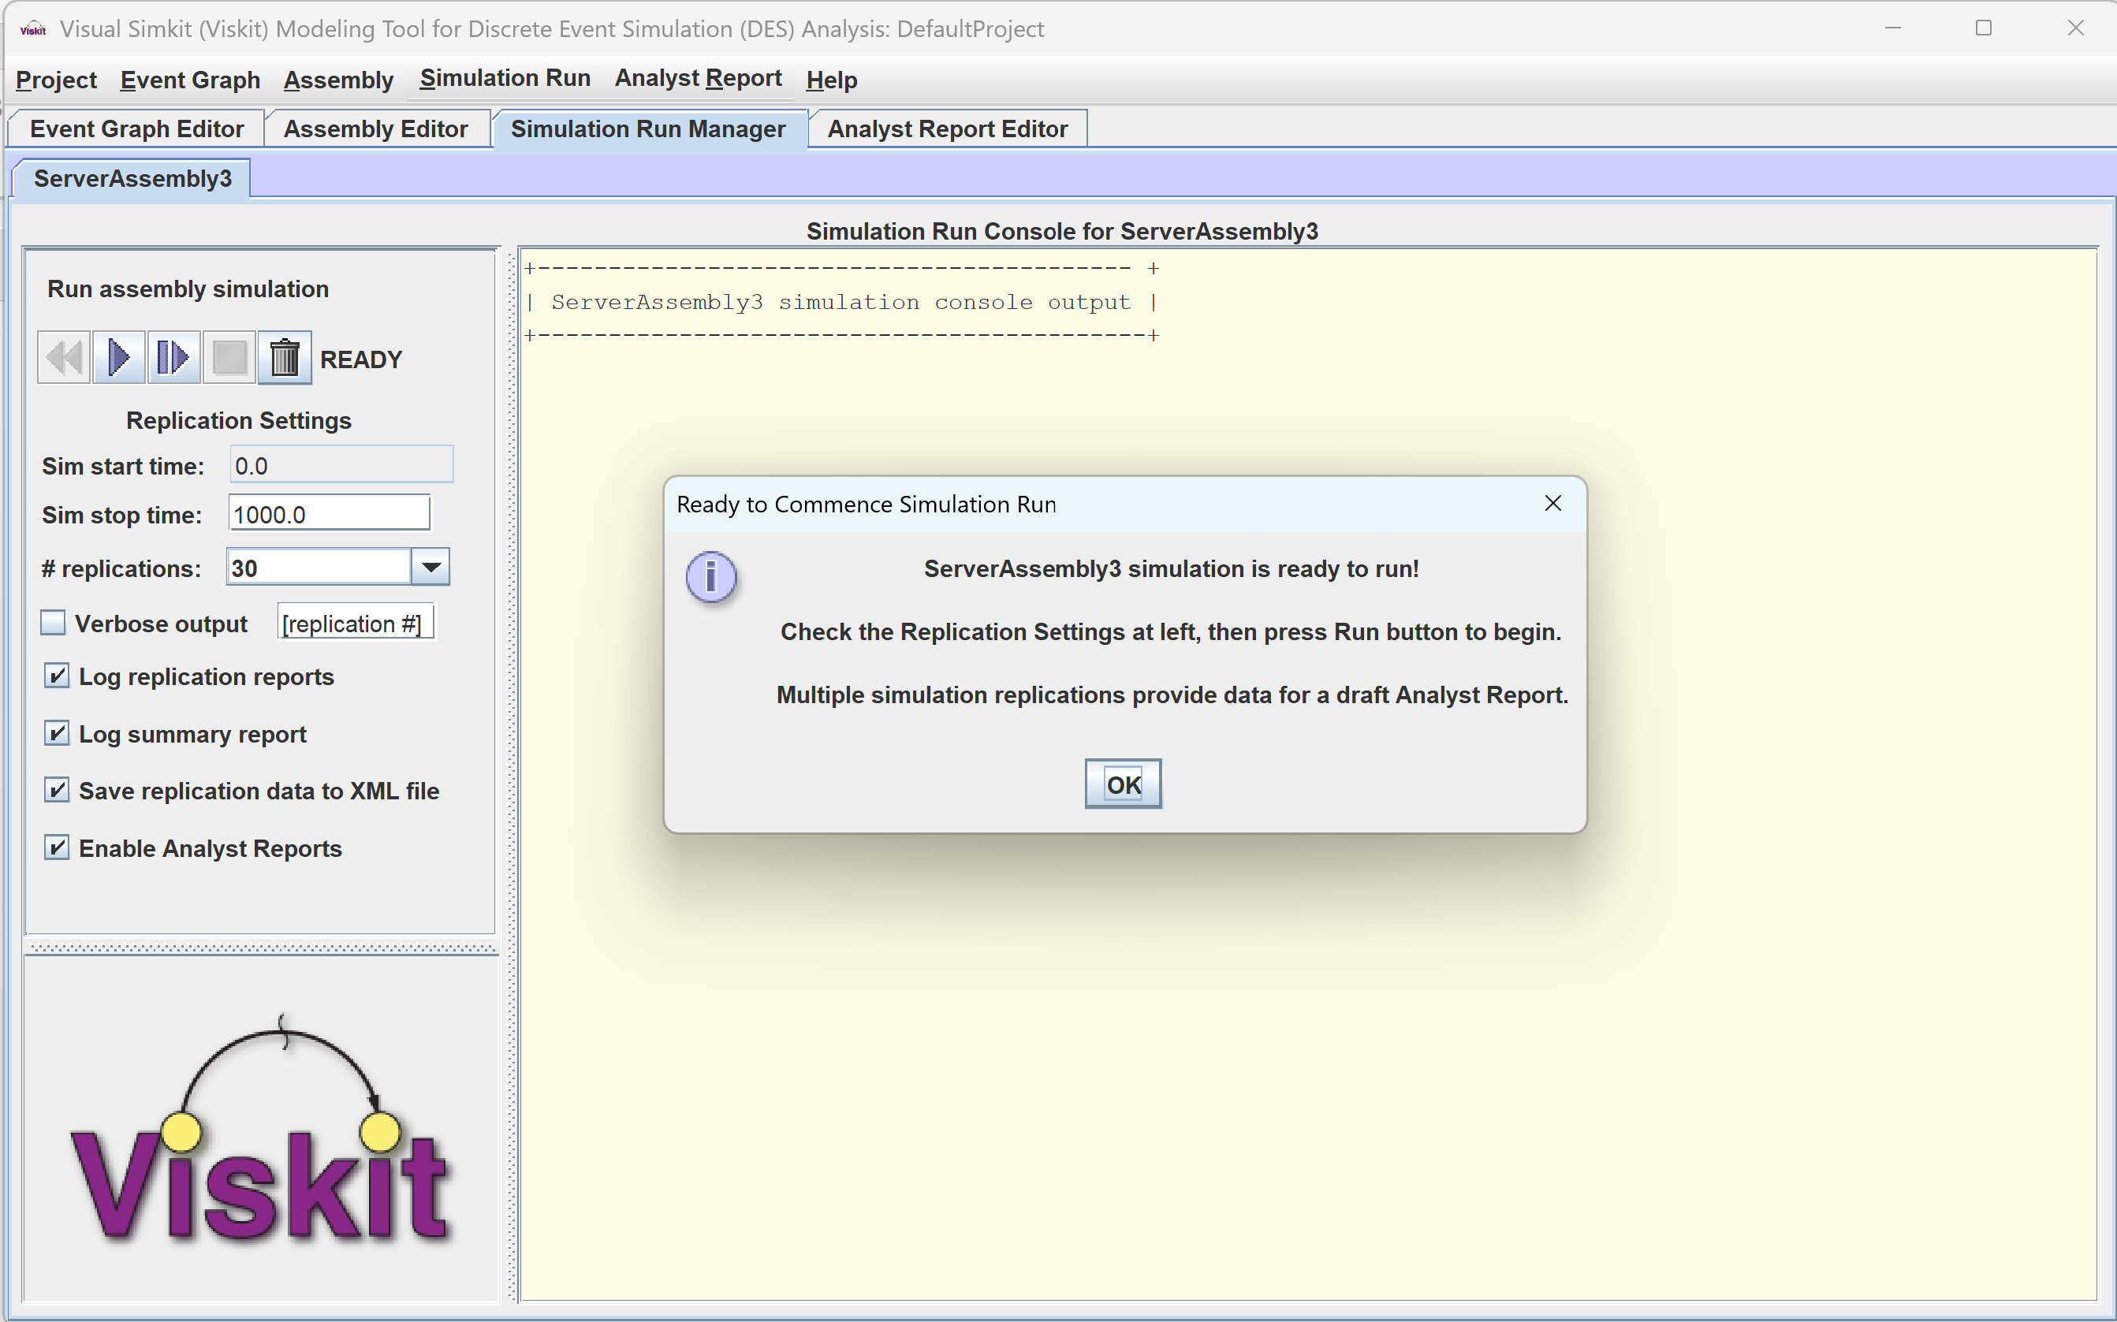
Get set to run simulations

Slide 23
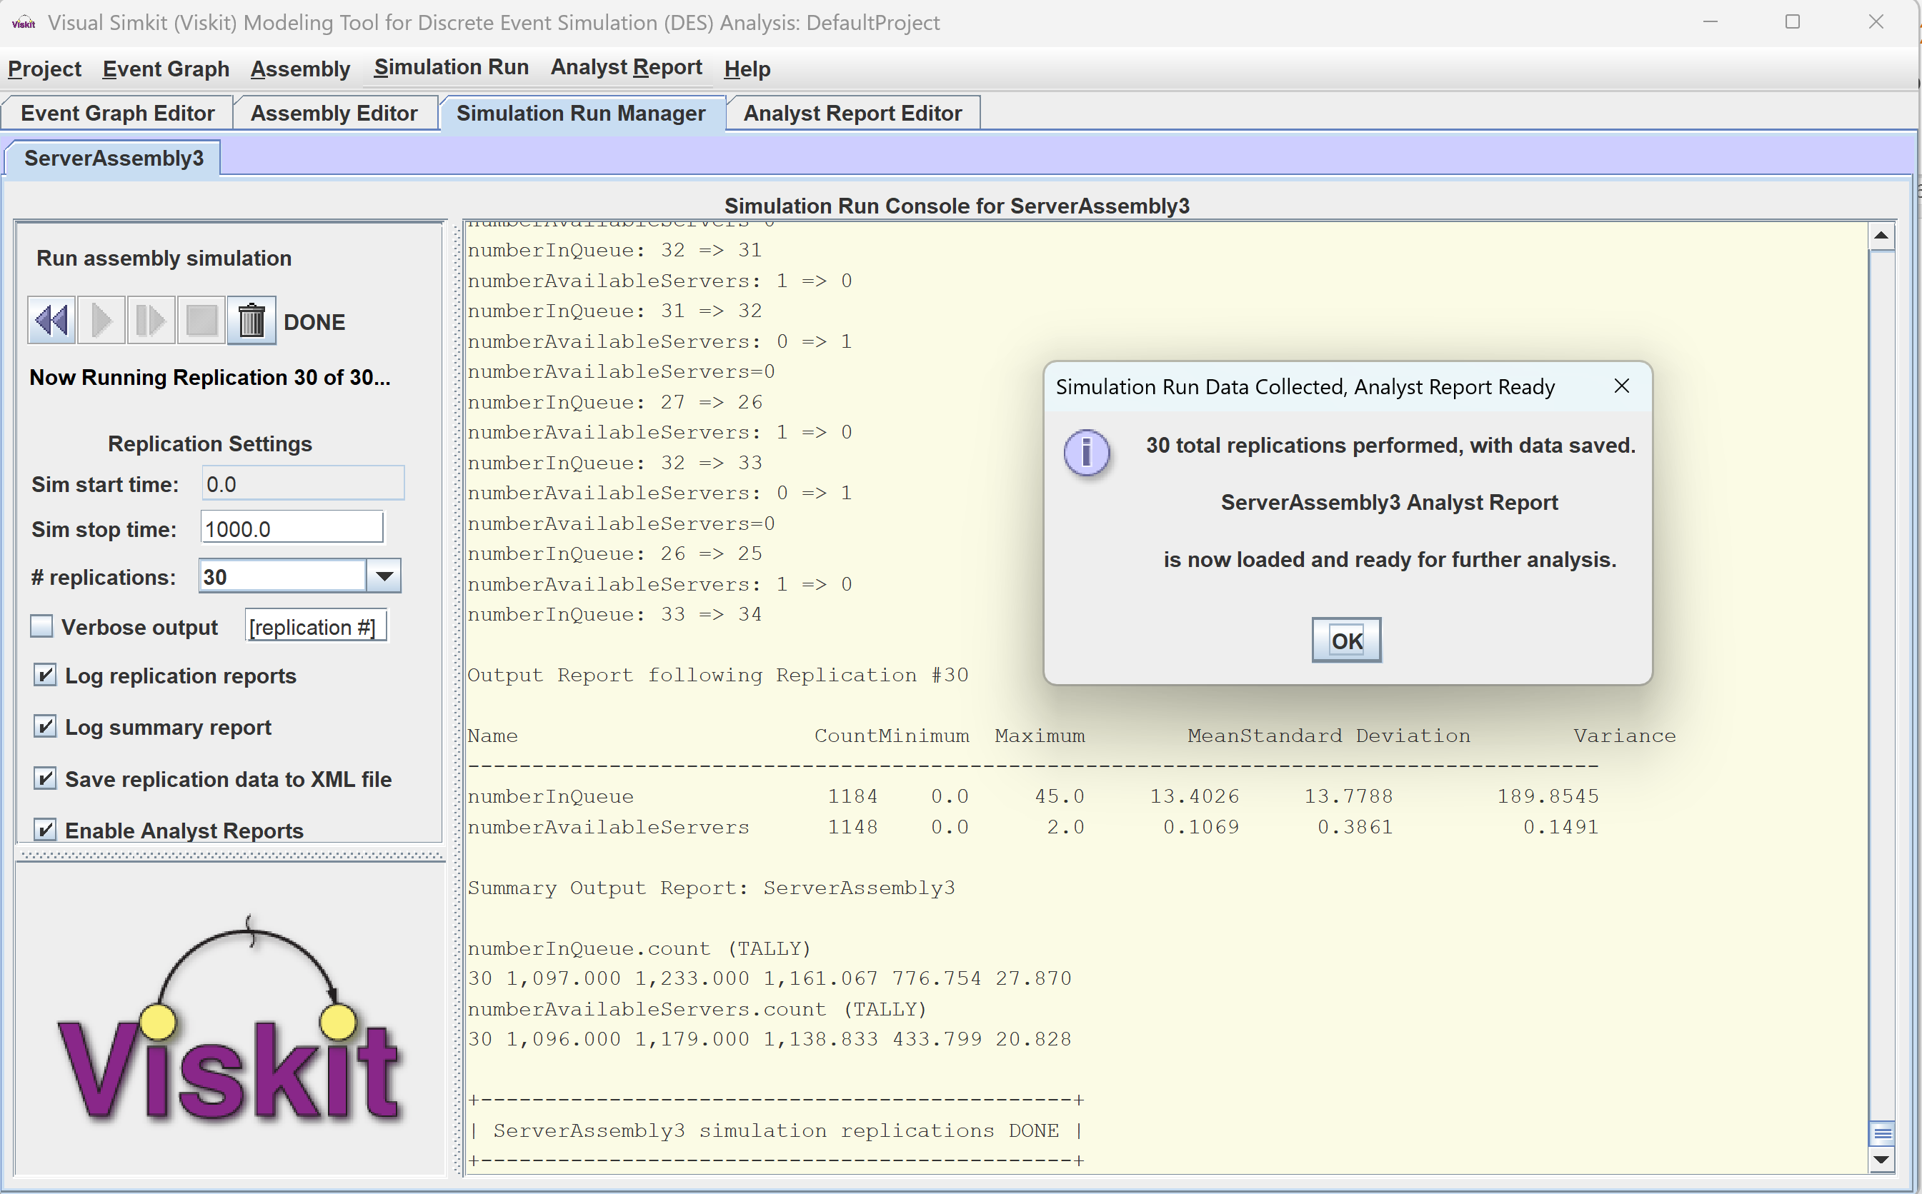
Go! Run simulations

Slide 24
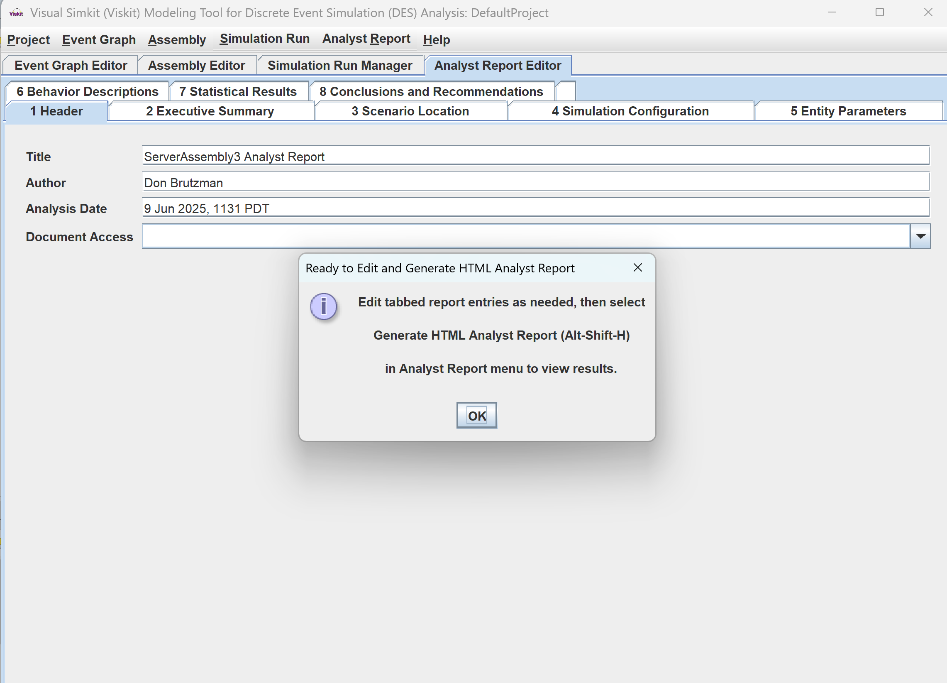
Simulation replications complete Edit Analyst Report data

Slide 25
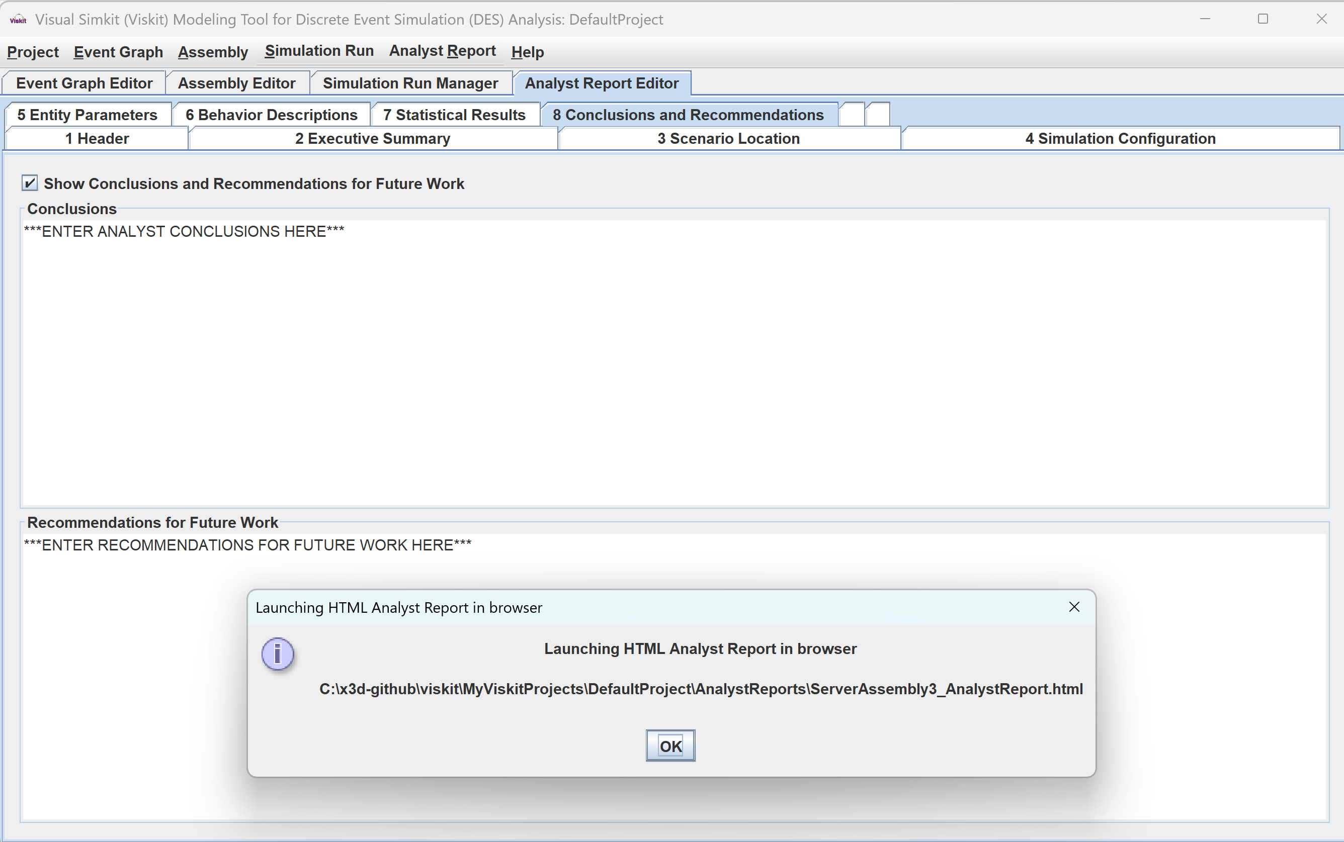
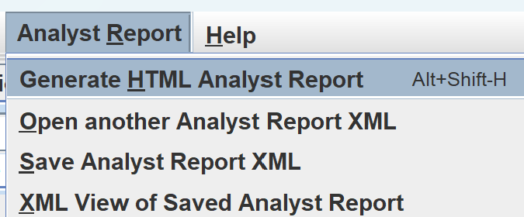
When ready, launch HTML Analyst Report in browser

Slide 26
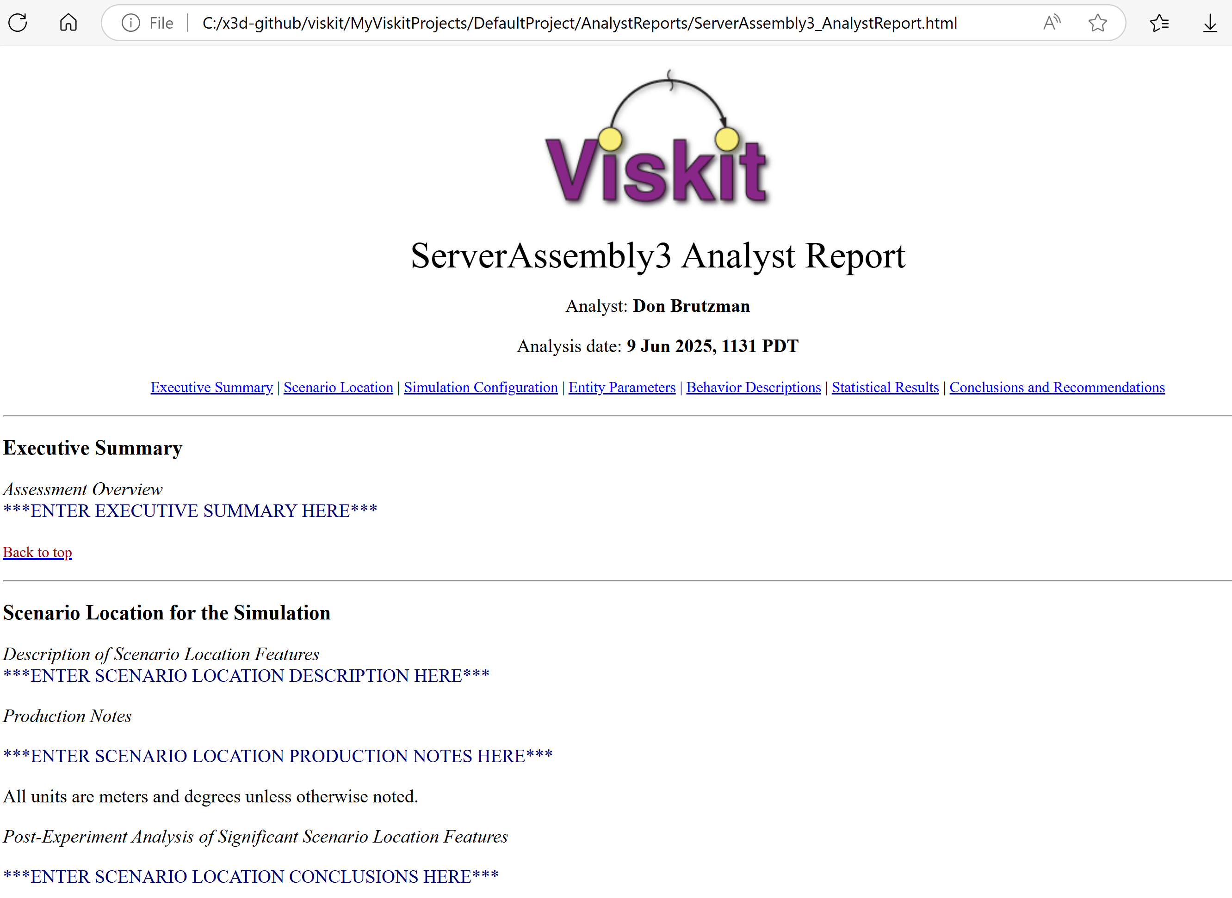
Analyst Report 1

Slide 27
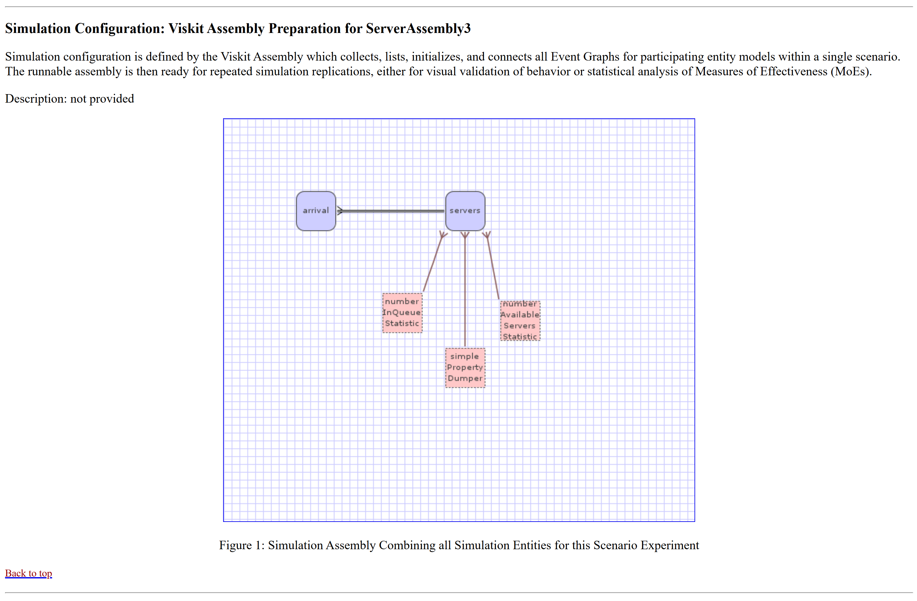
Analyst Report 2

Slide 28
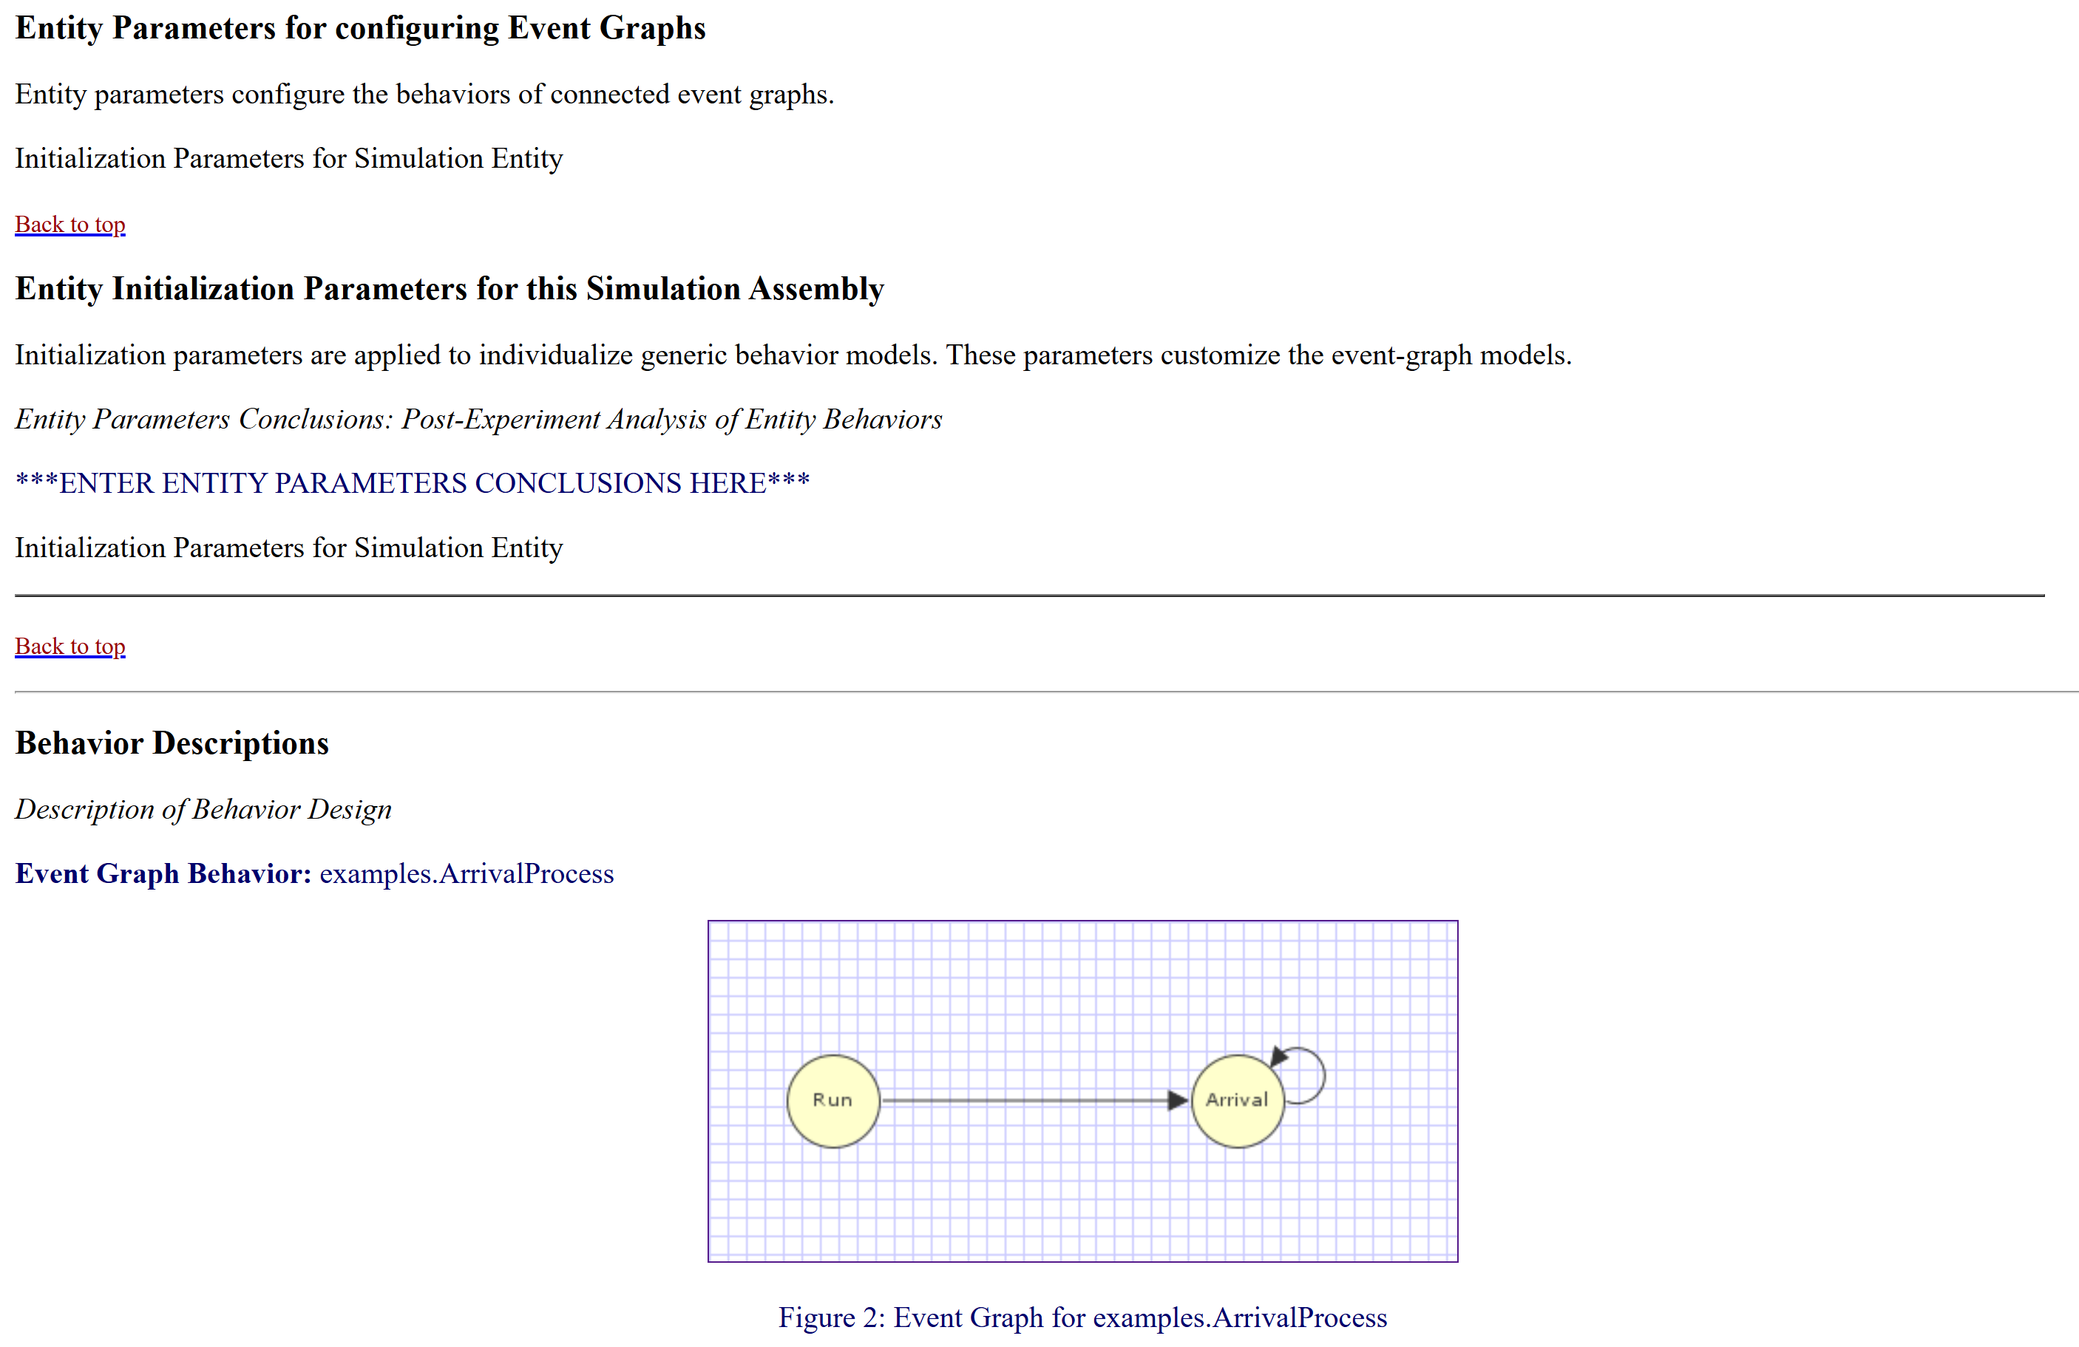
Analyst Report

Slide 29
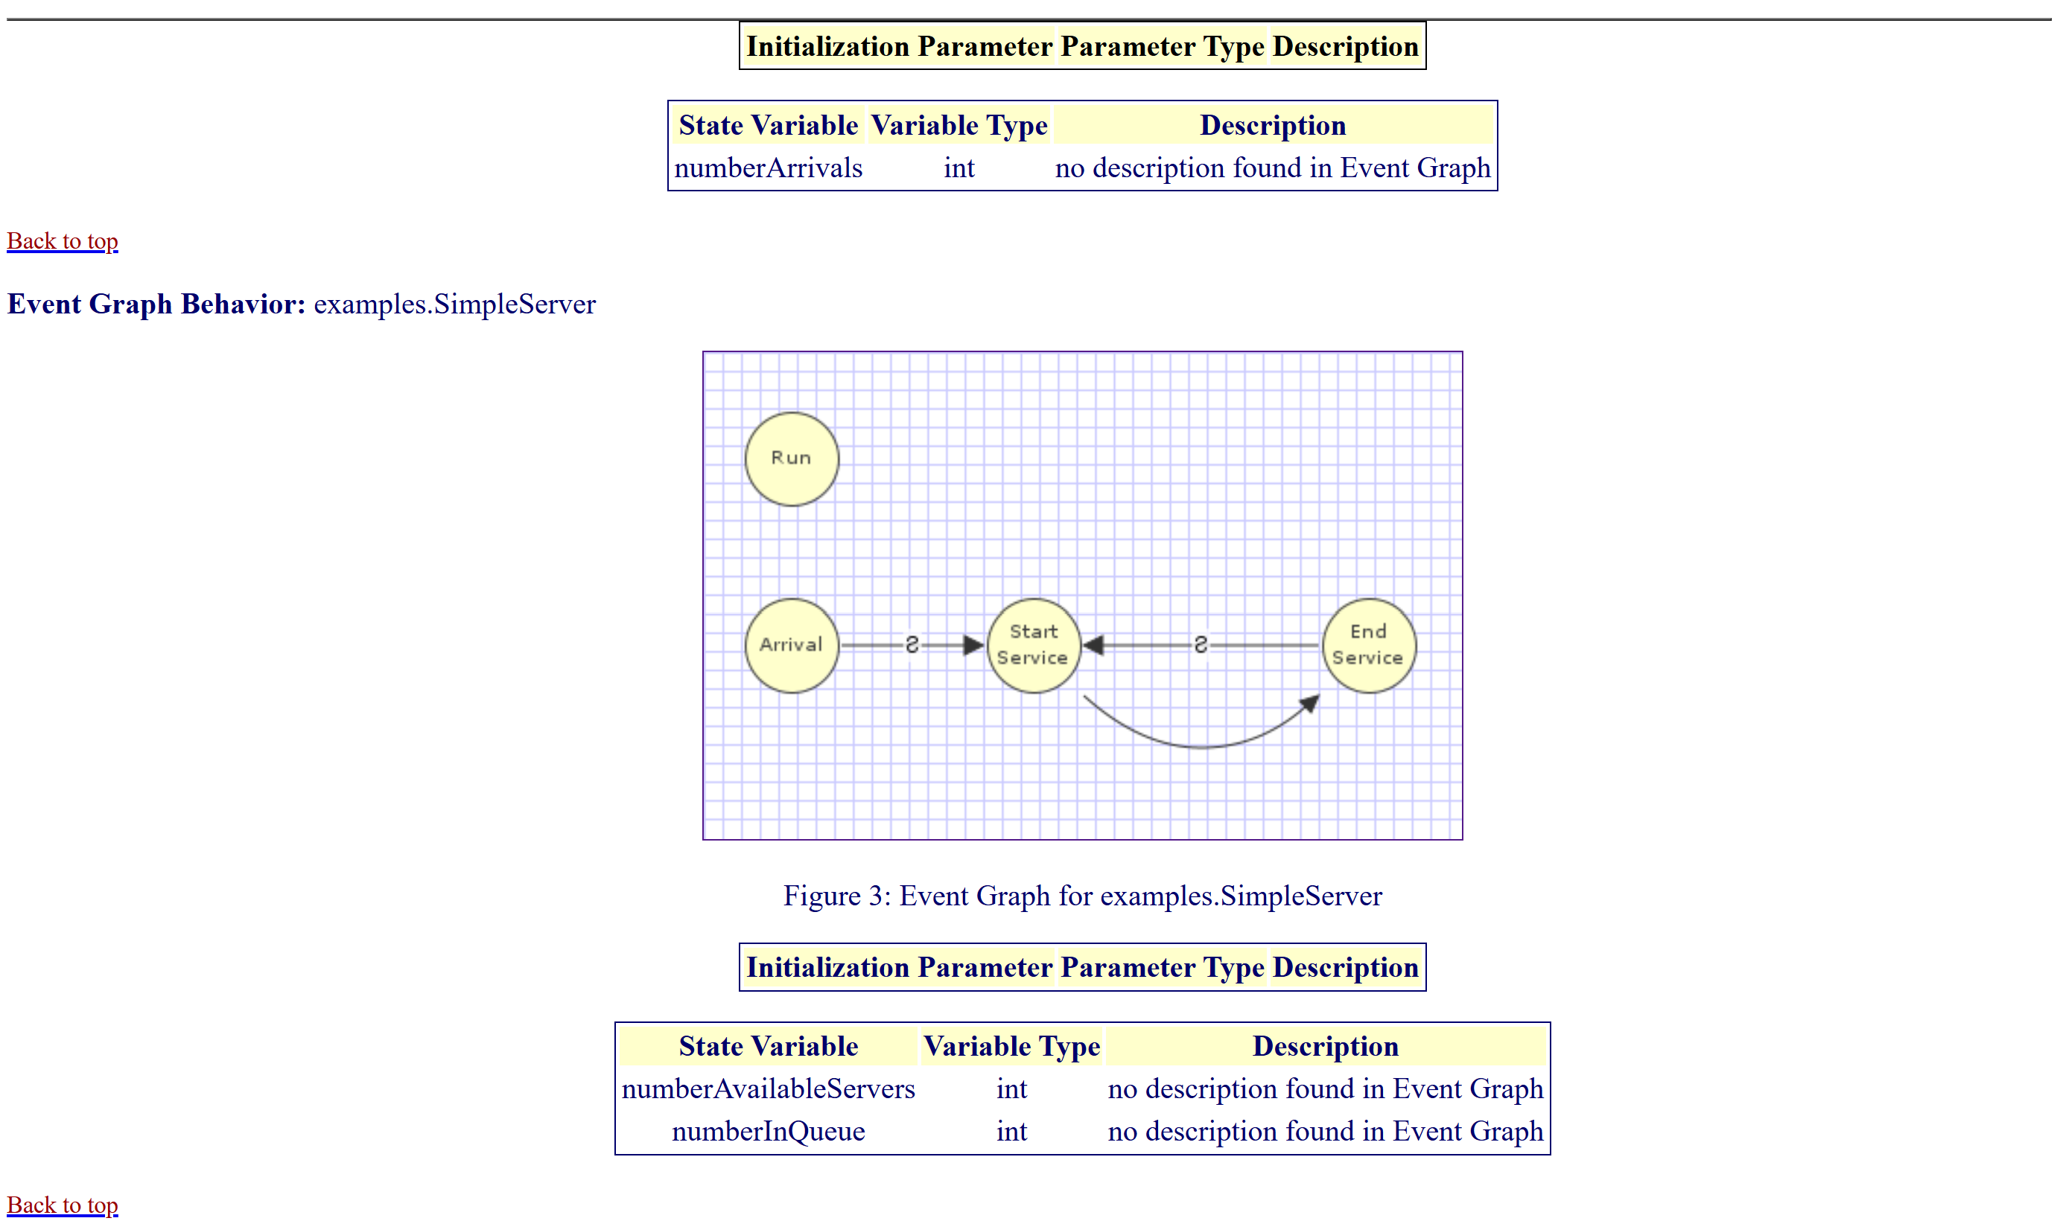
Analyst Report

Slide 30
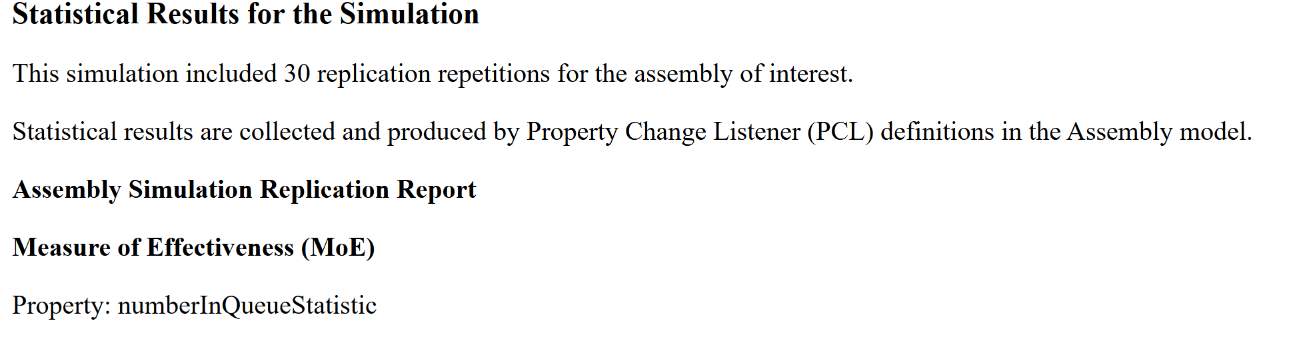
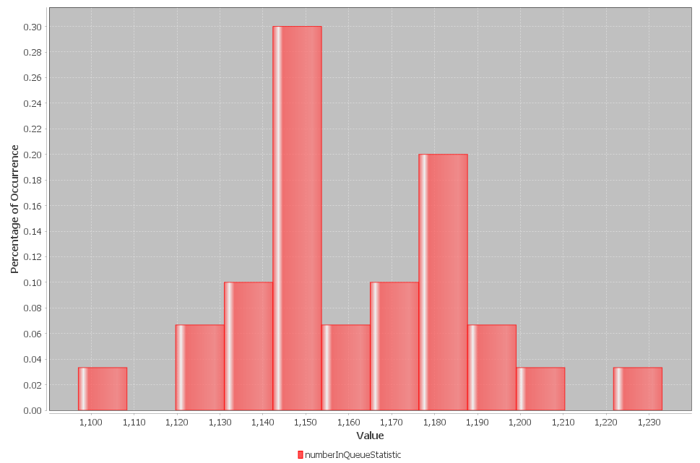
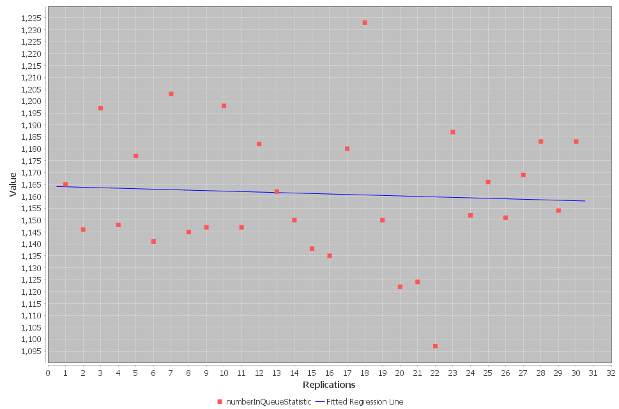
Analyst Report 3

Slide 31
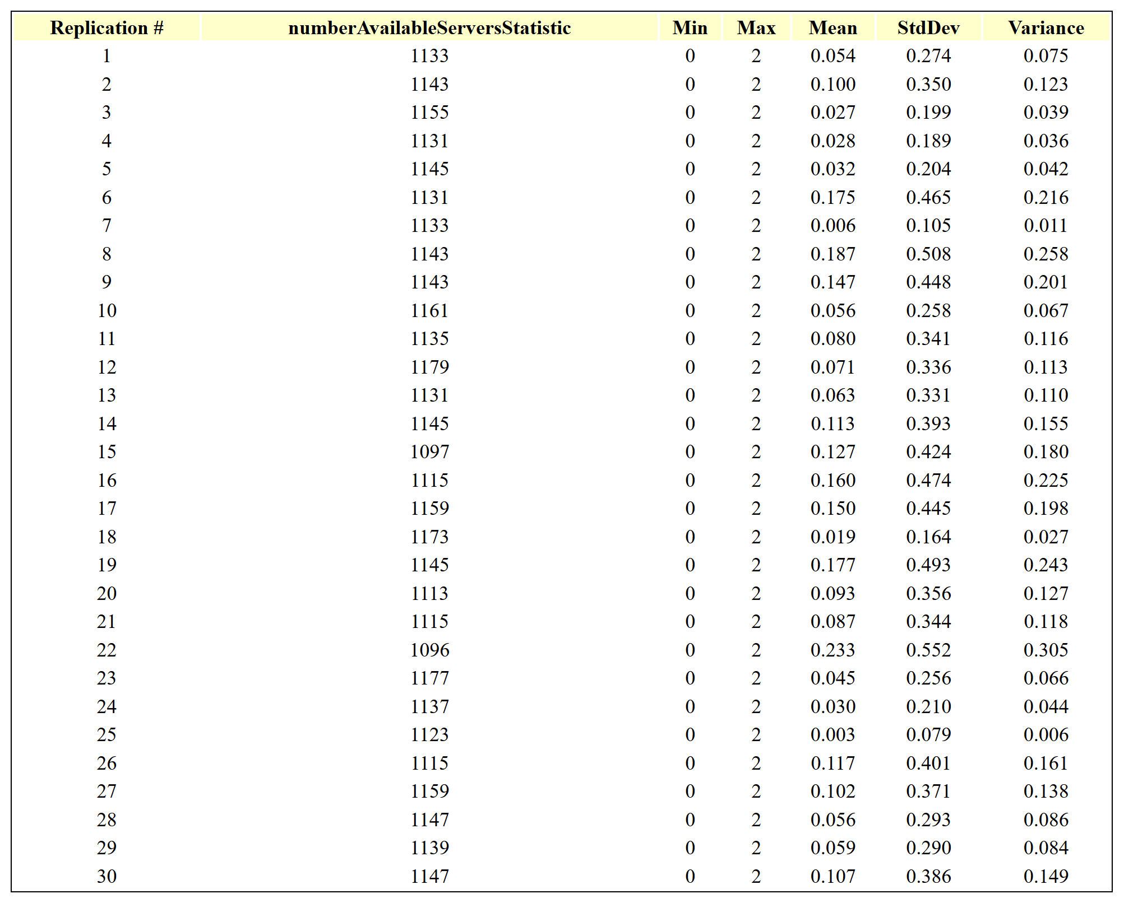
Analyst Report 4

Slide 32
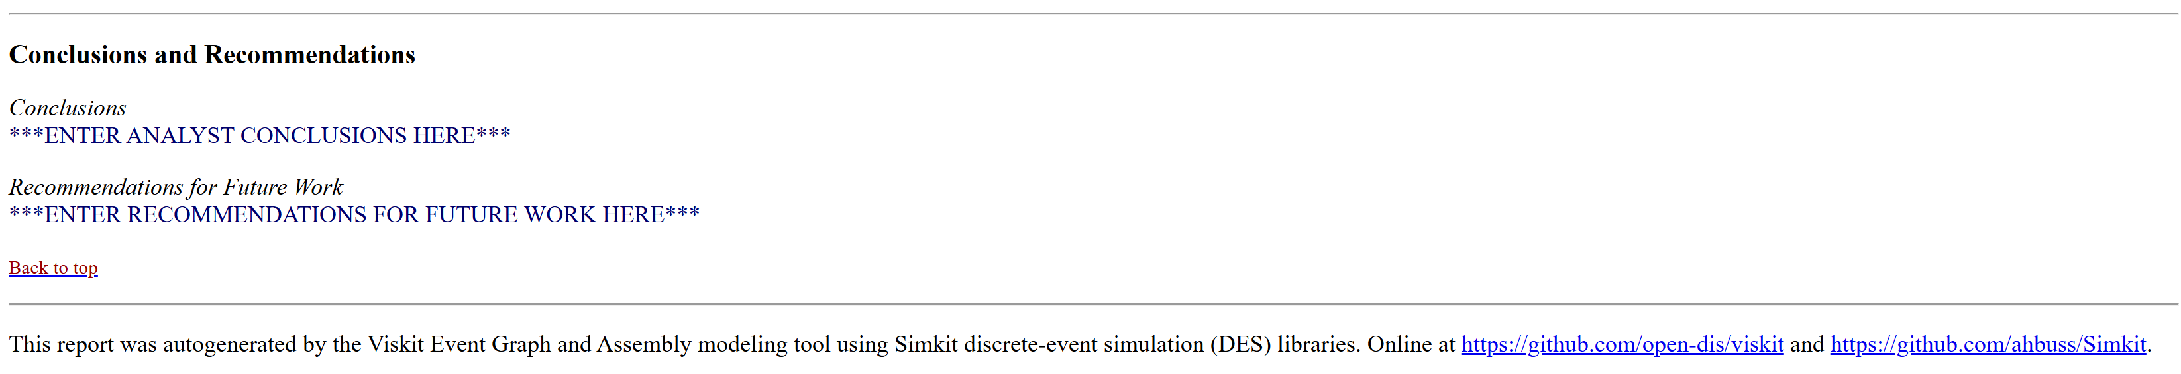
Analyst Report Completion
Thus well suited for iterative analysis and experimentation
Report files can be saved and reopened as needed – archival.
Improvements ongoing and suggestions are always welcome

Slide 33
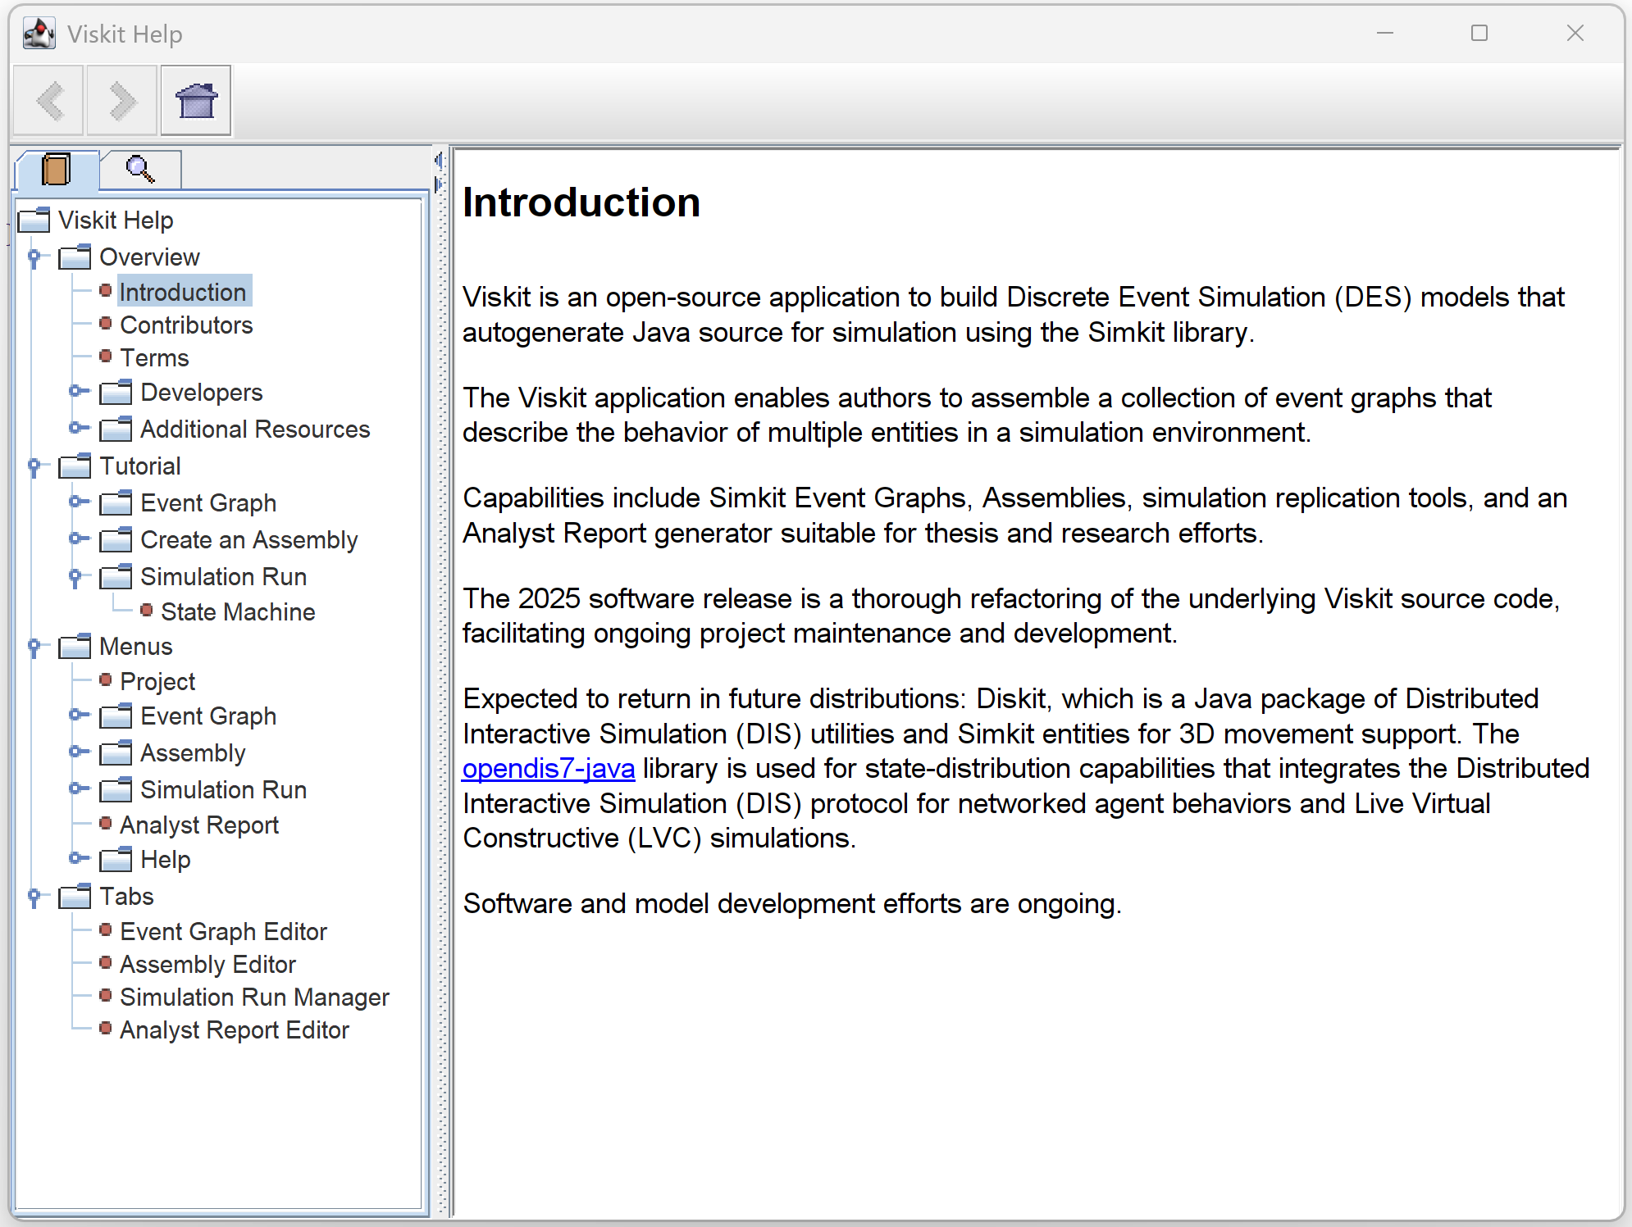
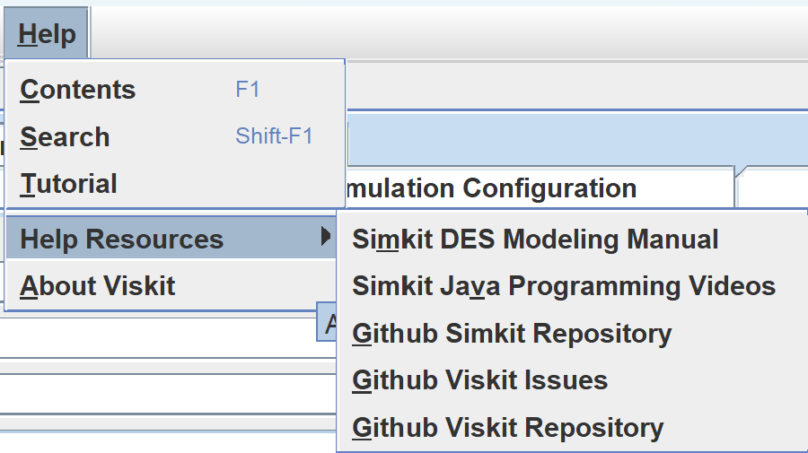
Help
To learn everything you want from Professor Arnie Buss:
Simkit Discrete Event Simulation (DES) Modeling Manual
Simkit Java Programming Videos

Slide 34
Infrastructure
Open source version control
Viskit codebase, Simkit analytics codebase, model libraries

Slide 35
Open-source license
Copyright (c) 1995-2025 held by the author(s). All rights reserved.
Redistribution and use in source and binary forms, with or without modification, are permitted provided that the following conditions are met:
Redistributions of source code must retain the above copyright notice, this list of conditions and the following disclaimer.
Redistributions in binary form must reproduce the above copyright notice, this list of conditions and the following disclaimer in the documentation and/or other materials provided with the distribution.
Neither the names of the Naval Postgraduate School (NPS) Modeling Virtual Environments and Simulation (MOVES) Institute nor the names of its contributors may be used to endorse or promote products derived from this software without specific prior written permission.
THIS SOFTWARE IS PROVIDED BY THE COPYRIGHT HOLDERS AND CONTRIBUTORS "AS IS" AND ANY EXPRESS OR IMPLIED WARRANTIES, INCLUDING, BUT NOT LIMITED TO, THE IMPLIED WARRANTIES OF MERCHANTABILITY AND FITNESS FOR A PARTICULAR PURPOSE ARE DISCLAIMED. IN NO EVENT SHALL THE COPYRIGHT OWNER OR CONTRIBUTORS BE LIABLE FOR ANY DIRECT, INDIRECT, INCIDENTAL, SPECIAL, EXEMPLARY, OR CONSEQUENTIAL DAMAGES (INCLUDING, BUT NOT LIMITED TO, PROCUREMENT OF SUBSTITUTE GOODS OR SERVICES; LOSS OF USE, DATA, OR PROFITS; OR BUSINESS INTERRUPTION) HOWEVER CAUSED AND ON ANY THEORY OF LIABILITY, WHETHER IN CONTRACT, STRICT LIABILITY, OR TORT (INCLUDING NEGLIGENCE OR OTHERWISE) ARISING IN ANY WAY OUT OF THE USE OF THIS SOFTWARE, EVEN IF ADVISED OF THE POSSIBILITY OF SUCH DAMAGE.

Slide 36
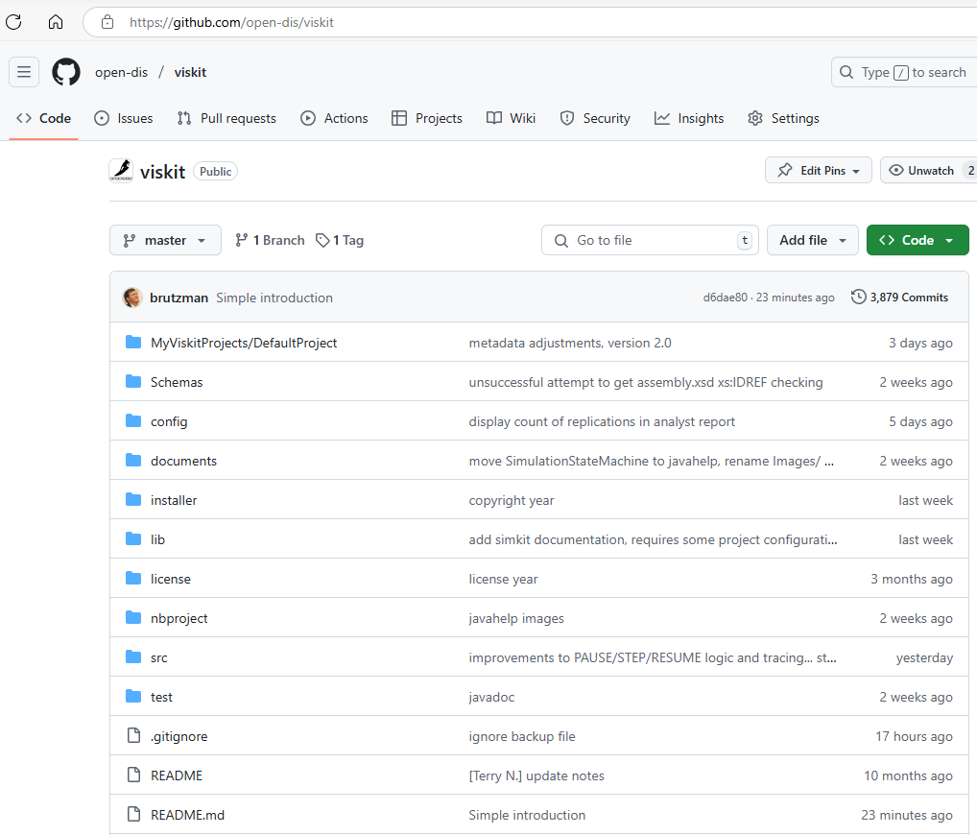
Open-source repository has moved to github https://github.com/open-dis/viskit
Previously hosted at https://gitlab.nps.edu/Savage/viskit to all NPS personnel
(U.S. and international)
Inclusion under open-dis project will hopefully encourage broad use and further contributions

Slide 37
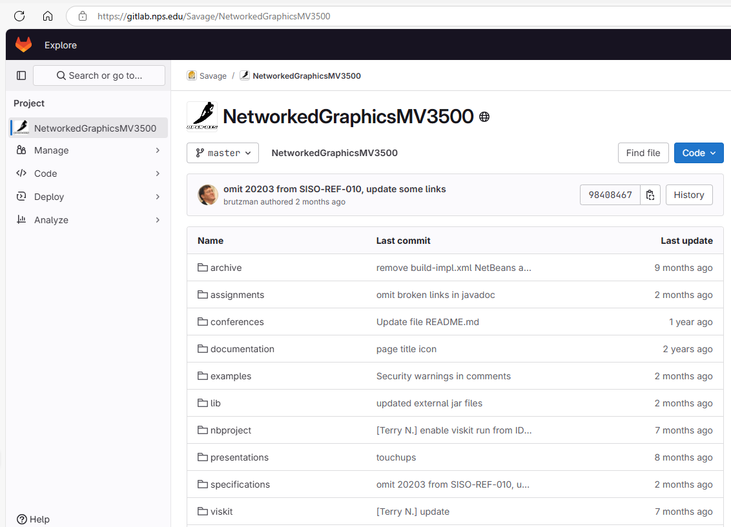
MV3500 Networked Graphics for Simulation https://gitlab.nps.edu/Savage/NetworkedGraphicsMV3500
Course slidesets and examples soon to migrate to github as well

Slide 38
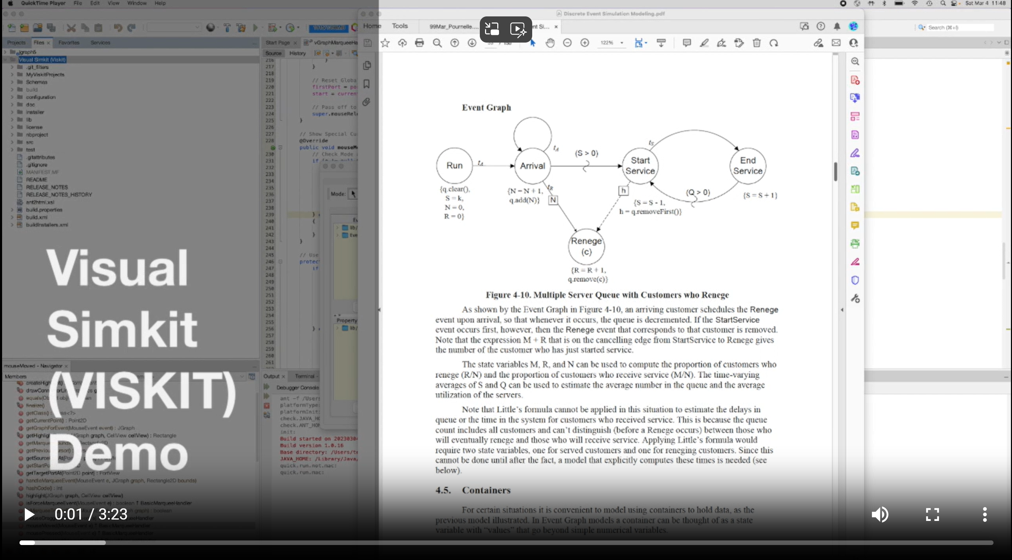
Viskit demo video https://savage.nps.edu/Savage/videos/Viskit-demo-2023MAR4.mp4

Slide 39
Contact
Don Brutzman
brutzman@nps.edu and don.brutzman@gmail.com
Terry Norbraten
tdnorbraten@nps.edu and terry.norbraten@gmail.com

